Slide 1
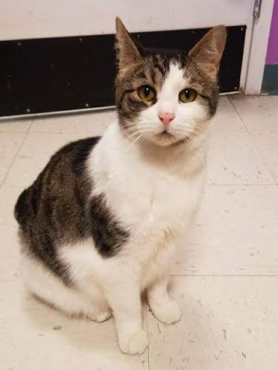
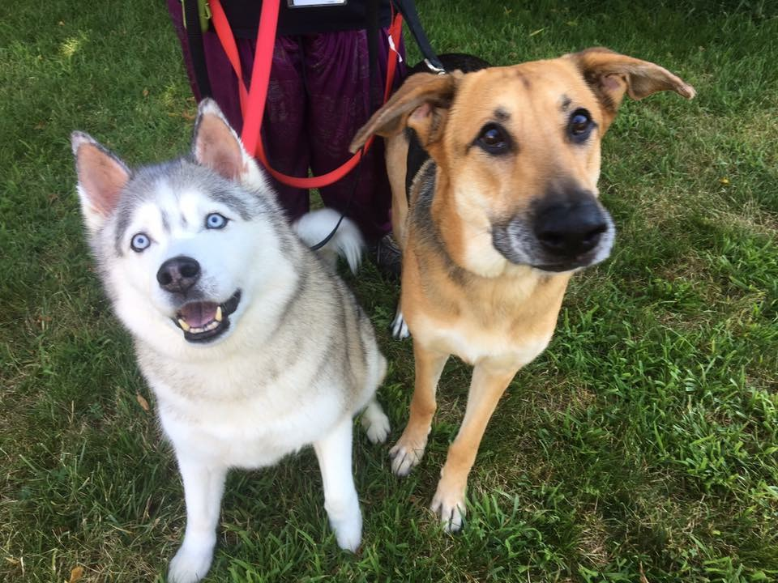
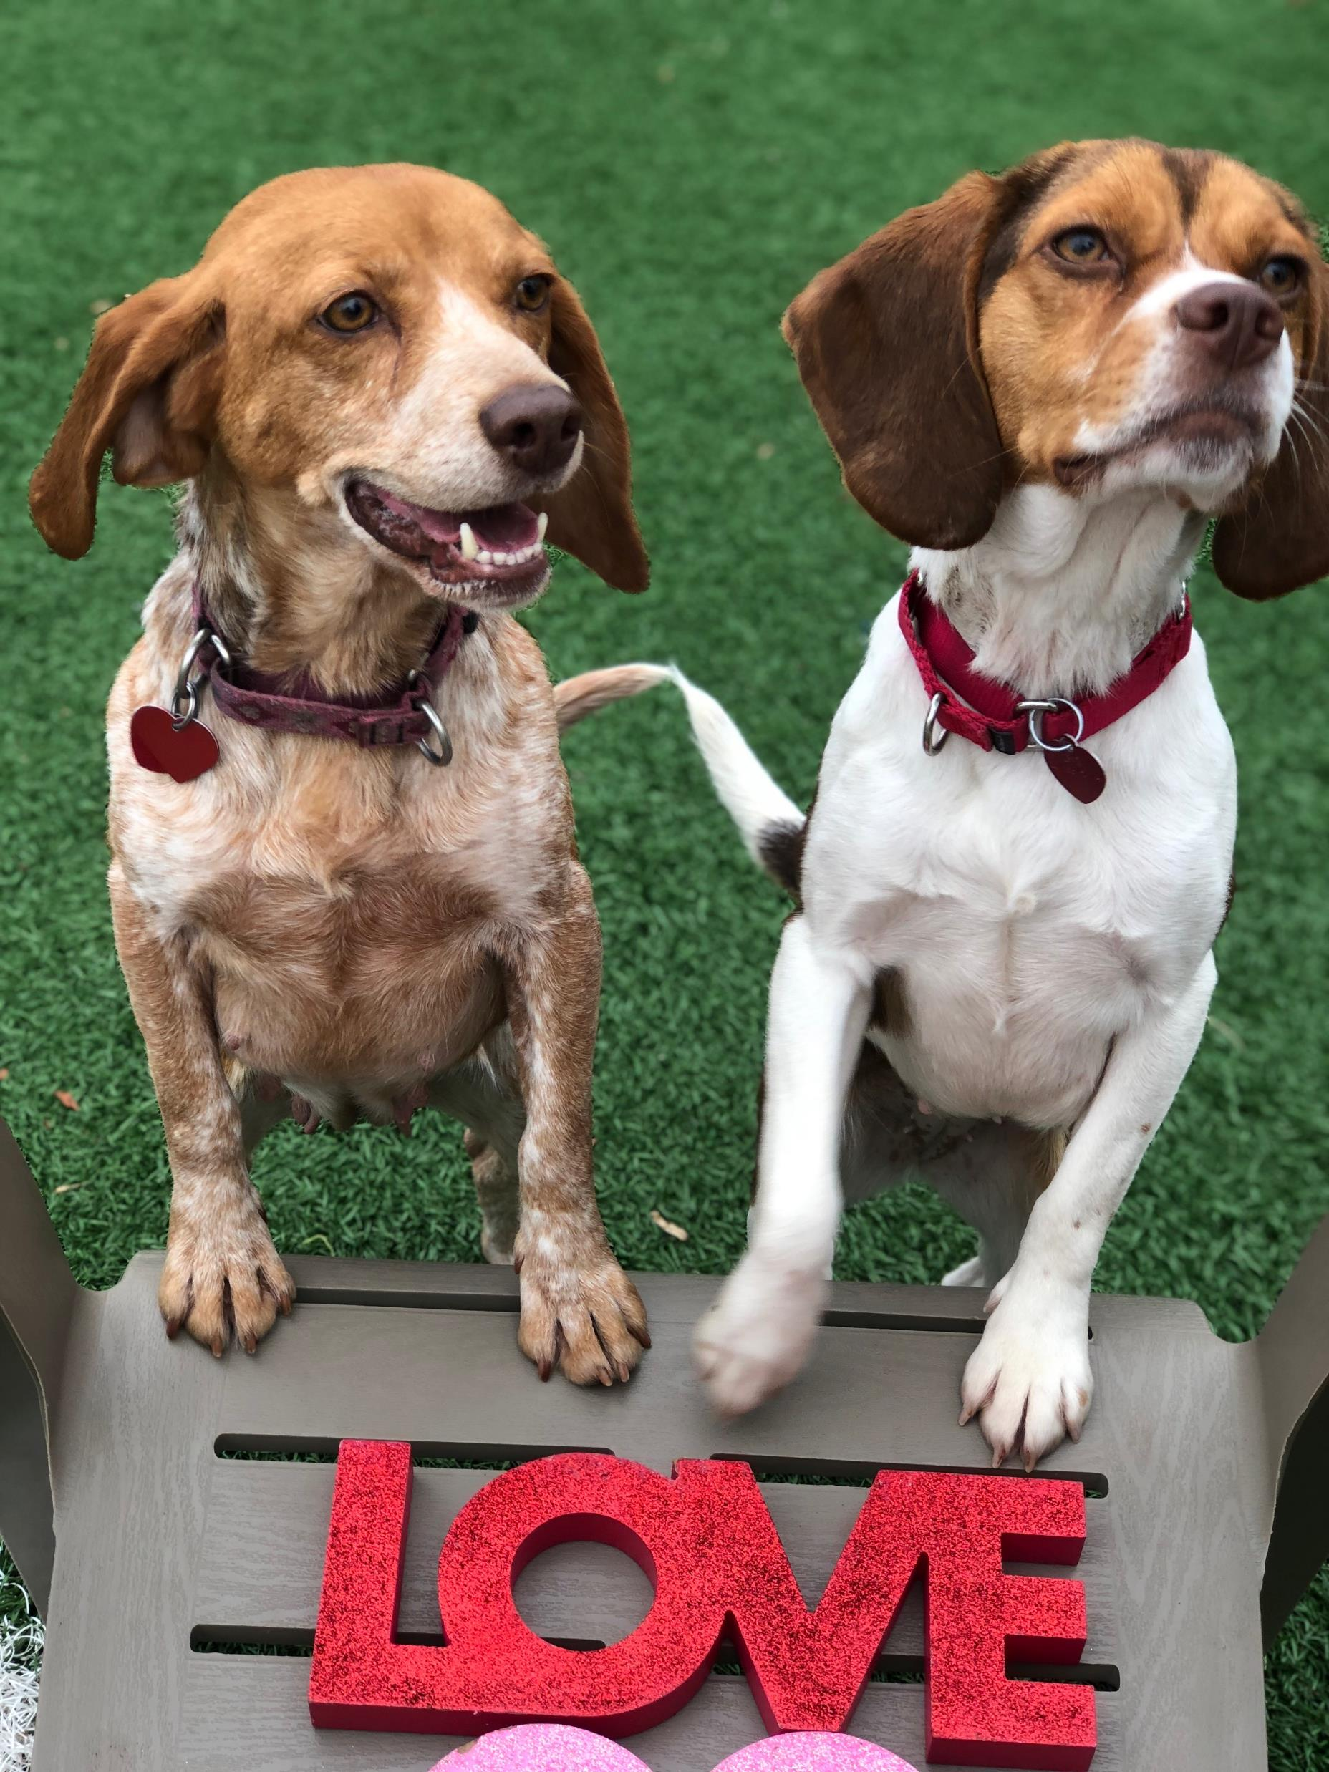
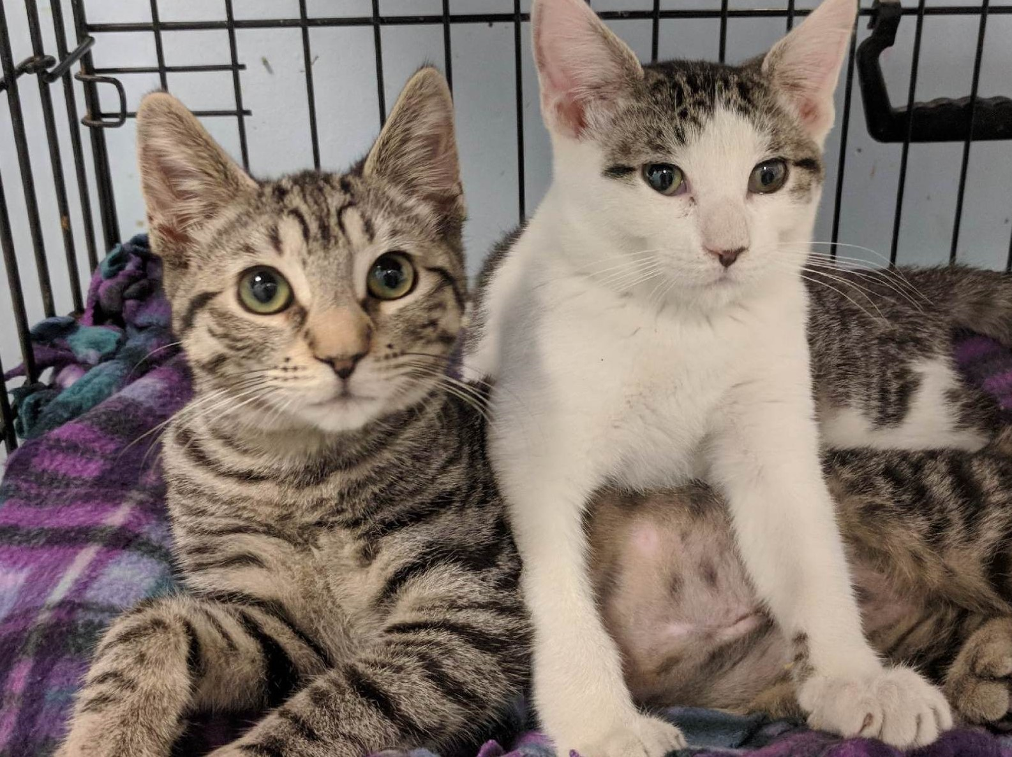
WELCOME TO RBARI’S 2018 ANNUAL MEETING

Slide 2
A Financial Overview of 2017 and Plans for the Future

Slide 3
Ramapo Bergen Animal Refuge, Inc.
Statement of Activities
For the Years Ended December 31, 2017, 2016, 2015 and 2014
 |  |  | 2017 |  | 2016 |  | 2015 |  | 2014
 |  |  | Unaudited |  | Audited |  | Audited |  | Audited
REVENUE
 | Fundraising |  | $ 378,076 |  | $ 258,279 |  | $ 222,229 |  | $ 284,583
 | Adoptions |  | 79,480 |  | 112,870 |  | 124,528 |  | 122,985
 | General Donations |  | 341,036 |  | 304,810 |  | 367,378 |  | 699,878
 | Grants & Foundations |  | 59,324 |  | 61,625 |  | 46,620 |  | 76,434
 | Gift Shop |  | 3,149 |  | 3,408 |  | 2,661 |  | 7,547
 |  |  | 861,065 |  | 740,992 |  | 763,416 |  | 1,191,427
Other
 | Bequests |  | 338,212 |  | 392,218 |  | 435,067 |  | 2,672
 | Investment Income & Other |  | 334 |  | 1,840 |  | 5,090 |  | 9,521
 |  |  | 338,546 |  | 394,058 |  | 440,157 |  | 12,193
Total Revenue and Other |  |  | $ 1,199,611 |  | $ 1,135,050 |  | $ 1,203,573 |  | $ 1,203,620
EXPENSES
 | Program Services |  | $ 1,367,325 |  | $ 1,215,659 |  | $ 835,958 |  | $ 704,465
 | Management & General |  | 117,885 |  | 183,429 |  | 88,281 |  | 93,560
 | Fundraising |  | 18,590 |  | 7,488 |  | 21,247 |  | 26,191
 | Total Expenses |  | 1,503,800 |  | 1,406,576 |  | 945,486 |  | 824,216
(Decrease)/Increase in Net Assets |  |  | $ (304,189) |  | $ (271,526) |  | $ 258,087 |  | $ 379,404

Slide 4
Ramapo Bergen Animal Refuge, Inc.
Statement of Financial Position
For the Years Ended December 31, 2017, 2016, 2015 and 2014
 |  |  | 2017 |  | 2016 |  | 2015 |  | 2014
 |  |  | Unaudited |  | Audited |  | Audited |  | Audited
Assets
Cash & Equivalents |  |  | $ 742,844 |  | $ 849,476 |  | $ 1,166,365 |  | $ 886,998
Short Term Investments |  |  | 28,081 |  | 211,568 |  | 210,931 |  | 210,300
Property & Equipment, net |  |  | 853,548 |  | 888,548 |  | 778,421 |  | 773,411
 | Total Assets |  | $ 1,624,473 |  | $ 1,949,592 |  | $ 2,155,717 |  | $ 1,870,709
Liabilities
Accounts Payable and Acrrued Expenses |  |  | $ 107,529 |  | $ 128,459 |  | $ 63,058 |  | $ 36,137
Net Assets
Unrestricted |  |  | $ 1,244,185 |  | $ 1,623,375 |  | $ 1,775,889 |  | $ 1,508,509
Temporarily Restricted |  |  | 272,758 |  | 197,758 |  | 316,770 |  | 326,063
Total Net Assets |  |  | 1,516,944 |  | 1,821,133 |  | 2,092,659 |  | 1,834,572
 | Total Liabilities and Net Assets |  | $ 1,624,473 |  | $ 1,949,592 |  | $ 2,155,717 |  | $ 1,870,709

Slide 5
2017 Continues to be a year of Rebuilding
First full year for New Executive Director
Revenue increased 5.7% over 2016, Flat with 2015 and 2014
Efforts invested in new revenue sources
Fundraising increased 46% over 2016, and 70% over 2015, due to increased efforts and new events, such as Casino night, Golf Outing (resurrected from 2015) and Betty Lou Fund and Tricky Tray growth.
Major support from Bequests – over $300,000 in years 2017, 2016 and 2015.

Slide 6
Overview of Betty Lou Fund
2017 total $148,977 2018 Close to $60,000 to date
From the 2016 total of $43,669 the Betty Lou found increased by $105,308 in 2017.
The chart included highlights some of the totals for our bigger appeals. Additional funds came in not designated for a specific dog or cat.
Buster |  | 7,273
Maple & Leaf |  | 4,107
Fiona |  | 3,366
Confetti |  | 1,540
Marmalade |  | 7,811
Darcy |  | 1,164
Rumble |  | 11,012
Sydney |  | 10,016
Everly |  | 21,978
Joey |  | 4,051
Annabelle |  | 4,813
Louie |  | 1,363
Emma |  | 970
Hannah |  | 2,387
Lexi |  | 3,722
Coco |  | 23,584
Estelle |  | 8,061
Buffie |  | 2,300
Paterson 12 |  | 10,065
Bella |  | 3,680
Shar-Peis |  | 6,696
Kira |  | 24,485
Nosey |  | 5,170

Slide 7
Profitability of 2016 vs 2017 Events

Slide 8
2018 Events
For 2018 we have a new event Classics and Canines scheduled for Aug. 4th. This event will combine a classic car show with specialty food trucks and vendors to make for a fun community day out. It is set to take place at the Oakland rec. field. Please see our website for more details.
Tricky Tray is well on it’s way to being sold out!
We are continuing to expand our events along with our profitability under the leadership of our new Fundraising Chair.

Slide 9
Operating Expenses Increased in 2017 by $97,200.
Two major components:
Salaries – increase of 20% due to new ED and partial year of veterinarian and investment in staff for increase in hours of shelter operations
Veterinary Services – increase of 10% due to care for more sick animals
Expenses were revaluated and cut by the 4th quarter of 2017 with costs savings continuing into 2018. On average our continuing operating expenses are down by $16,648 per month in 2018 vs 2017.
Evaluation of expenditures commenced during 2017 and continue into 2018 to leverage buying power and the value of donated goods.
Employee handbook, policies and procedures were clarified during 2017 for better employment practices.

Slide 10
To create a stronger infrastructure, certain expenses had been approved in 2016 and 2017 based on resources on hand and the merits of the investment. Now, with those expenses incurred, the organization changes that have been implemented, the cost control efforts put into place, and our expanded fundraising efforts, we believe RBARI will be able to generate future revenues designed to cover its ongoing expenses. It is our goal to move away from our annual dependency on bequests towards more sustainable and predictable funding sources.

Slide 11
Revitalizing Adoptions in 2018
We saw a decline in adoptions in 2017 vs 2016.
We adopted 331 dogs in 2016 vs 285 in 2017
We adopted 384 cats in 2016 vs 177 in 2017
Factoring into these numbers:
In 2017 adoption days were expanded with the anticipation that more days would result in more adoptions. However, this did not pan out. We have since updated our adoption hours to include later adoption nights as opposed to more days open. We have seen an increase in adoptions for 2018 as a result.
In 2017 we faced consistent health issues requiring large sections of the cattery to be shut down for extended periods of time. Thanks to continued advancements in our veterinary care and protocols we are now seeing less illness and an increase in the health of our cats.

Slide 12
In 2018 we are enhancing our adoption experience through:
Greater access to training and increased post-adoption follow up and support.
Updating the website and PetFinder photos and bios of our dogs and cats -utilizing quality photos and personalized stories to help them stand out.
Undertaking a review of our adoption process, with exciting changes in the pipeline. Such as enhanced customer experience, working with our trainer to help facilitate adoption meets, faster promotion of our adoptable dogs and cats, as well improving the adoption experience.
For 2018 our adoption numbers are back on track with those of 2016 and anticipated to increase as additional improvements are implemented.

Slide 13
In 2018 we are continuing to expand our efforts to diversity our funding sources.
Adding our adopters data to our donor database expanding our reach in outgoing appeals and communications.
Focusing on engaging donors to give in reoccurring monthly amounts to provide stable and consistent funding.
Utilizing matching grants to drive reoccurring monthly giving.
Developing Feed-A-Friend - a program focused on generating sustainable food donations for our dogs and cats.
We are working with a pro bono financial consultant to undertake a deep dive and review of finances, donation and other processes by which such transactions are handled.
Implementing new processes and initiatives to eliminate redundancy and streamline the accuracy and handling of money.
The finance committee continues to explore cost saving with vendors and monitor spending.
Ensuring that spending cuts from the 4th quarter of 2017 remain in place for 2018

Slide 14
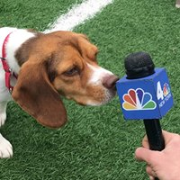
2017 A Newsworthy Year

Slide 15
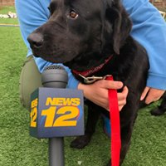
2017 was a big year for RBARI in the news. We received national and local media coverage that elevated our brand recognition and greatly expanded our support base.

Slide 16
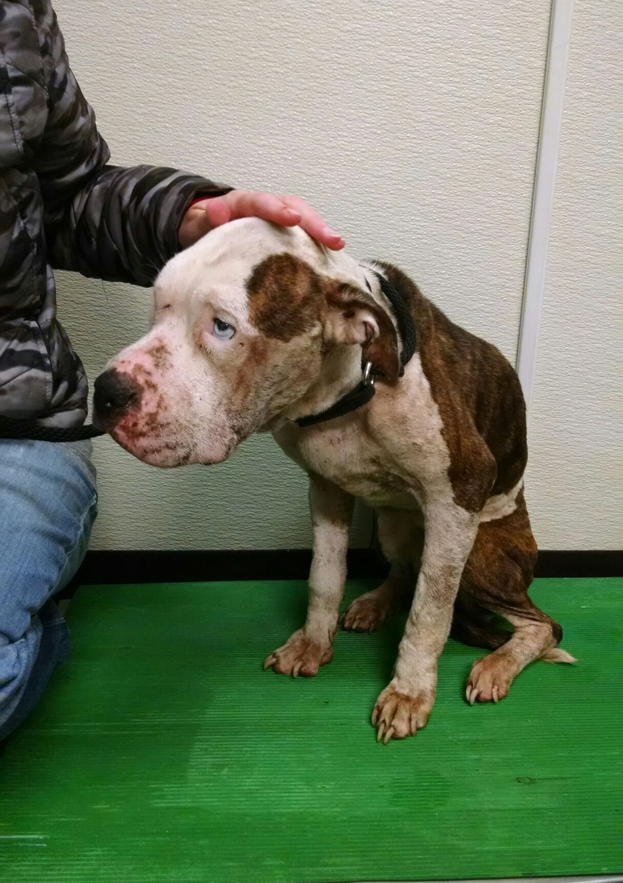
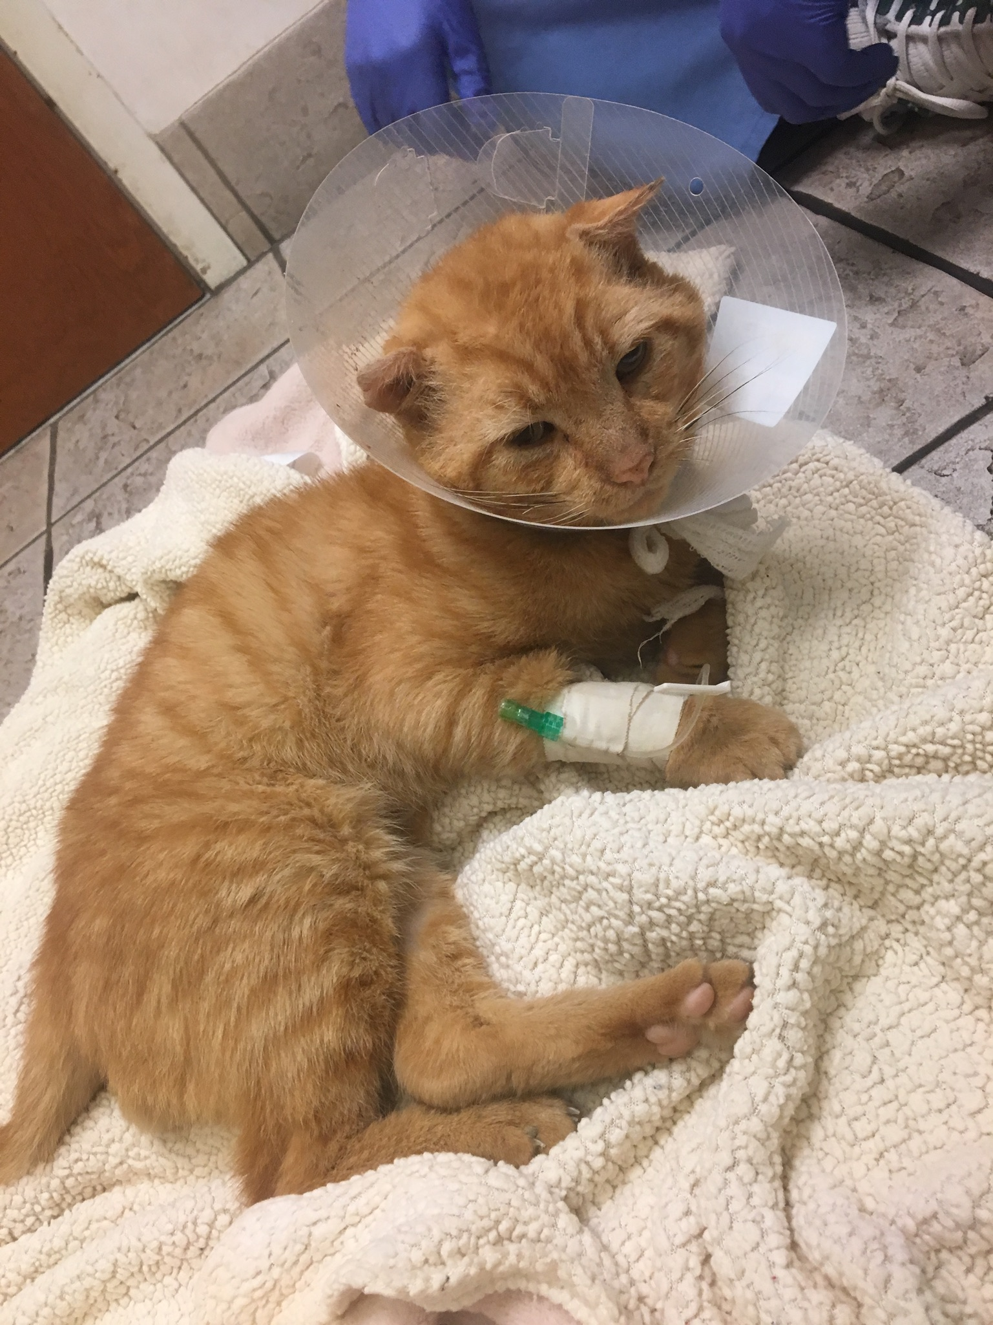
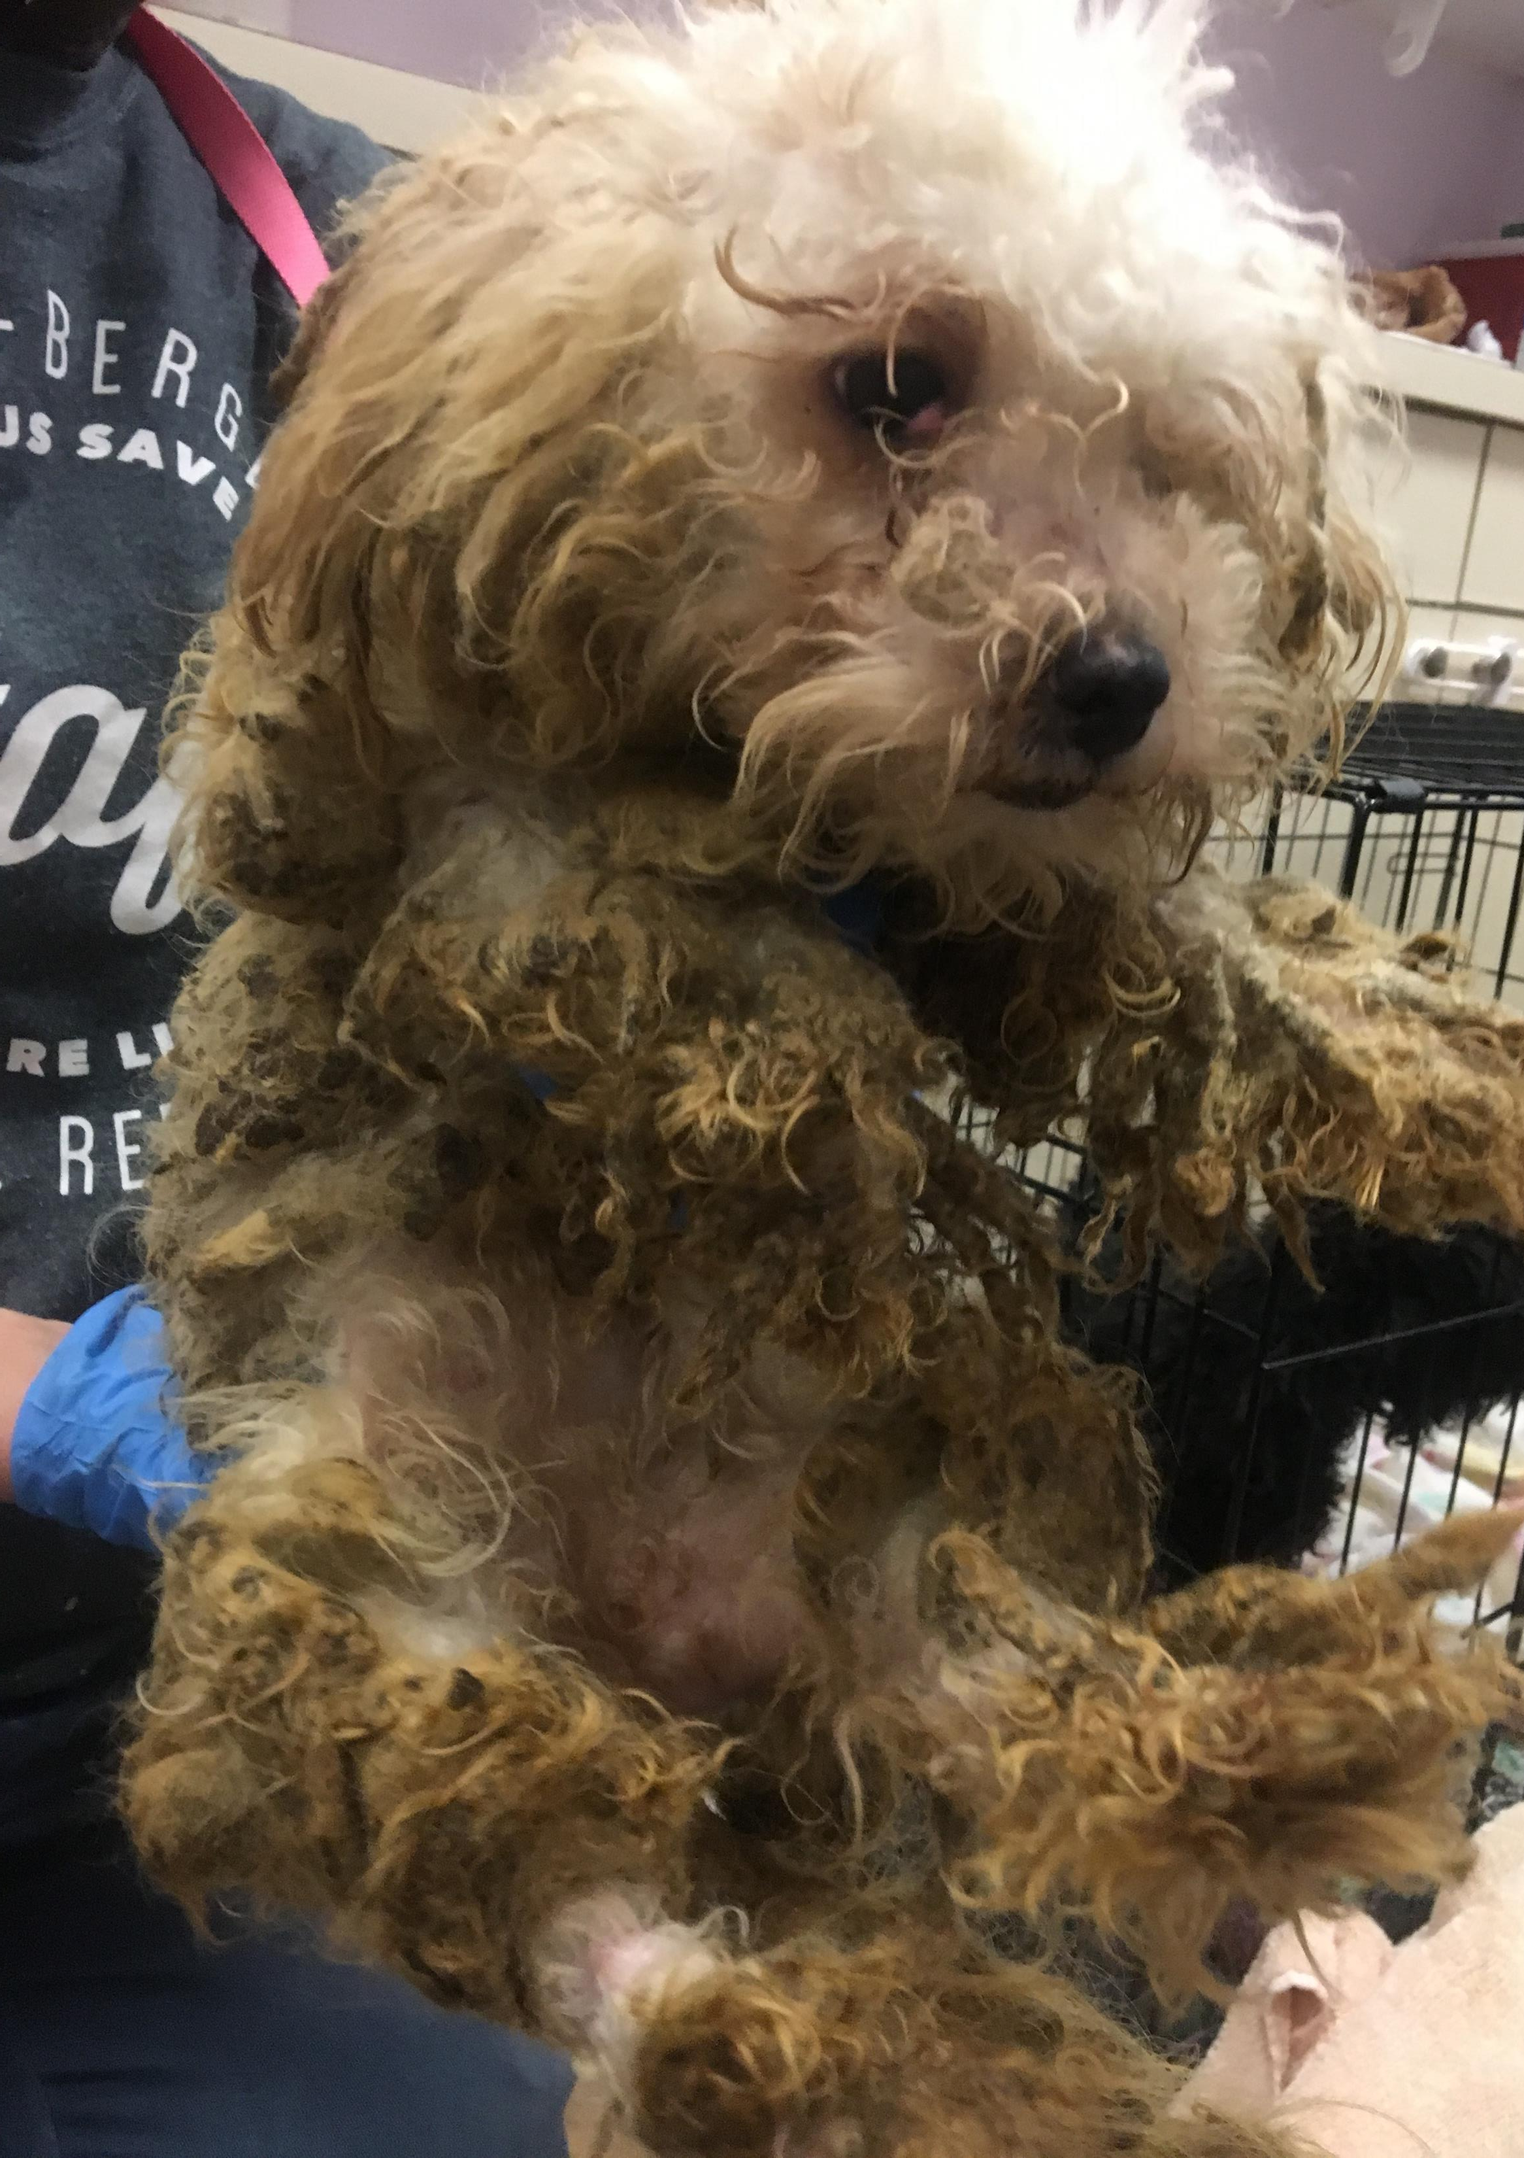
Engaging our contacts and community, RBARI was able to generate news coverage for our major rescue stories. Here are a few examples.

Slide 17
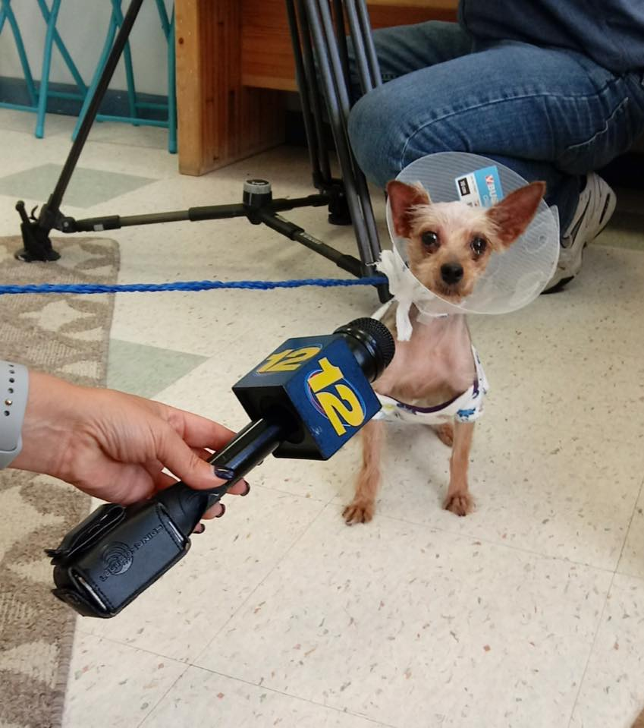
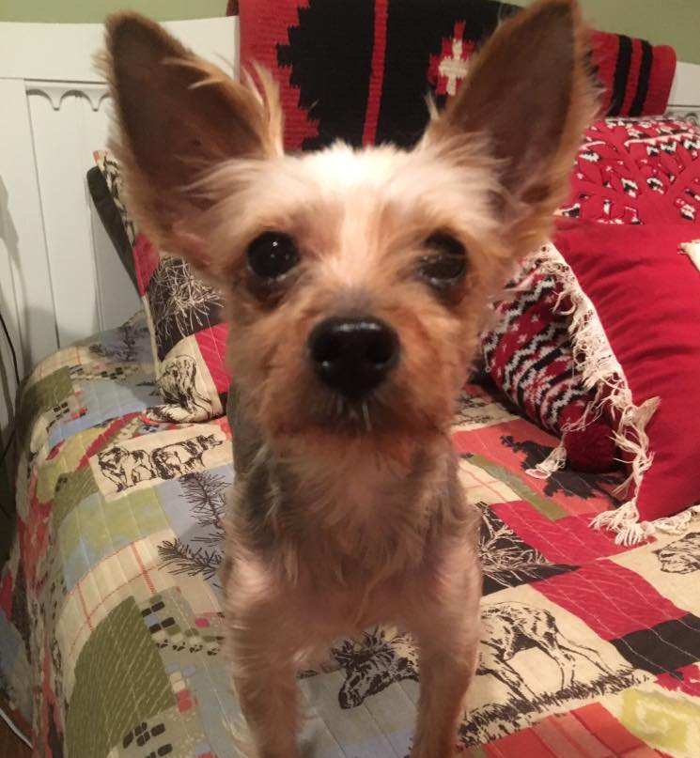
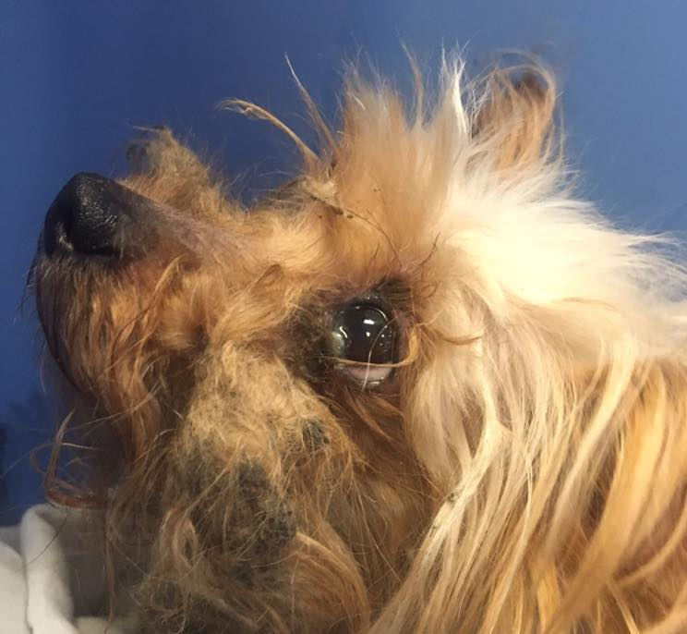
Sydney
After being thrown from a moving car, RBARI rescued Sydney who went on to find her forever home. NBC, ABC, News 12, NJ.com and Pix11 are some of the many outlets that aired or printed her story. Sydney helped to raise just over $10,000.

Slide 18
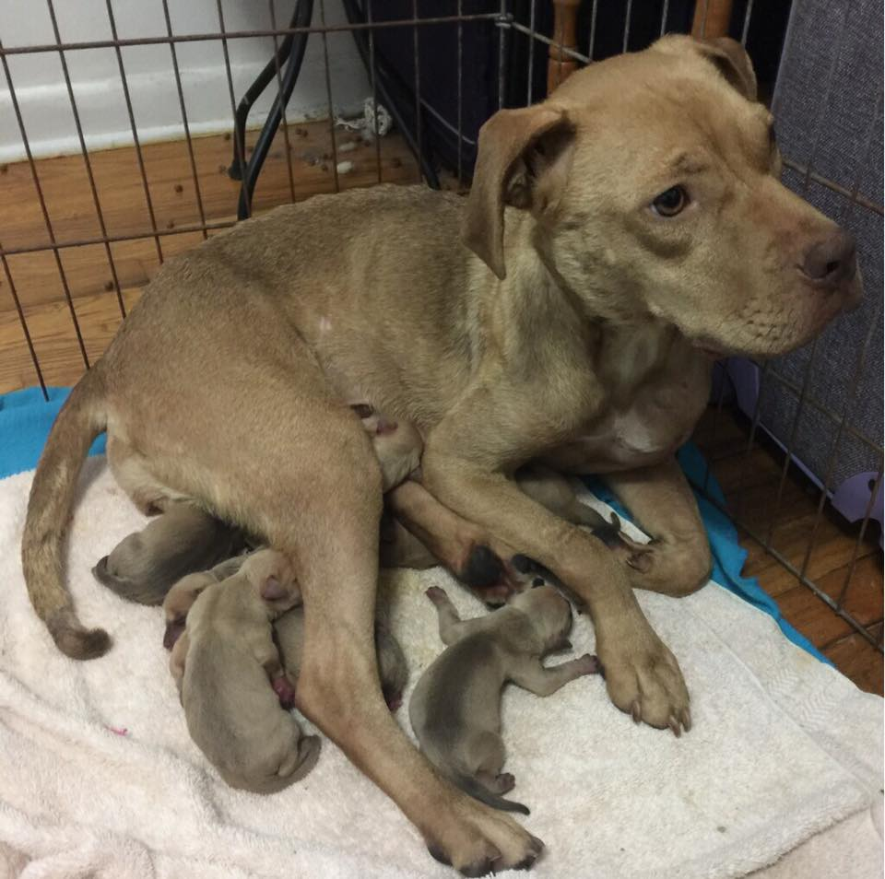
Everley and her babies
Everley was rescued by RBARI pregnant and emaciated, just having given birth to her 8 puppies. Everley also had a wound that had been callously stapled shut with a home stapler. Thanks to around the clock care and support, Everley and her babies grew strong and were treated for Babesia, a blood disease common among dogs forced into fighting rings.
All of the puppies went on to find their forever homes.

Slide 19
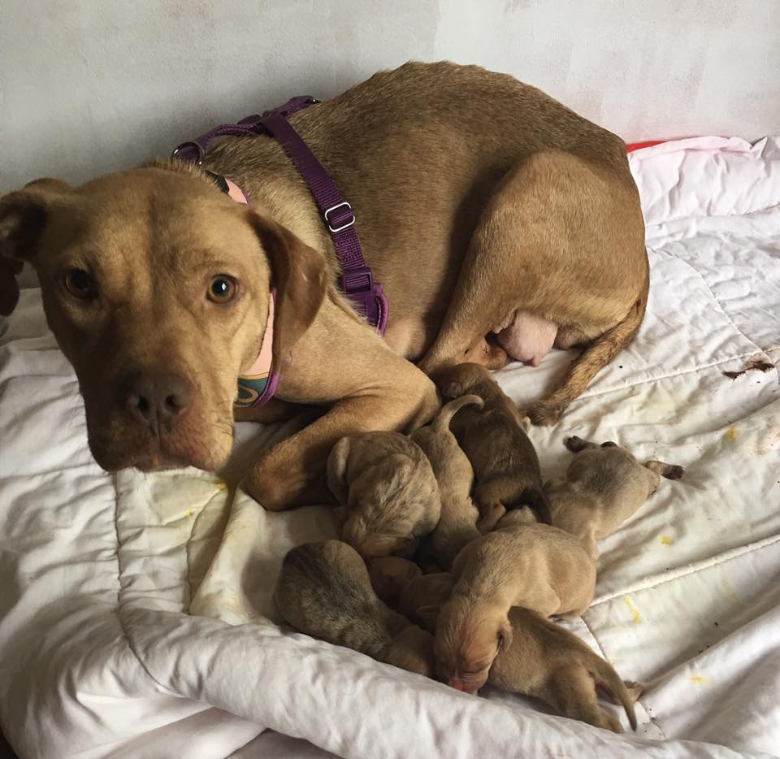
OAKLAND, New Jersey (WABC) -- The Ramapo-Bergen Animal Refuge in Bergen County, New Jersey is asking for help after a young, sick abused pit bull mix delivered 8 puppies.
This coverage helped directly lead to an outpouring of donations and support.

Slide 20
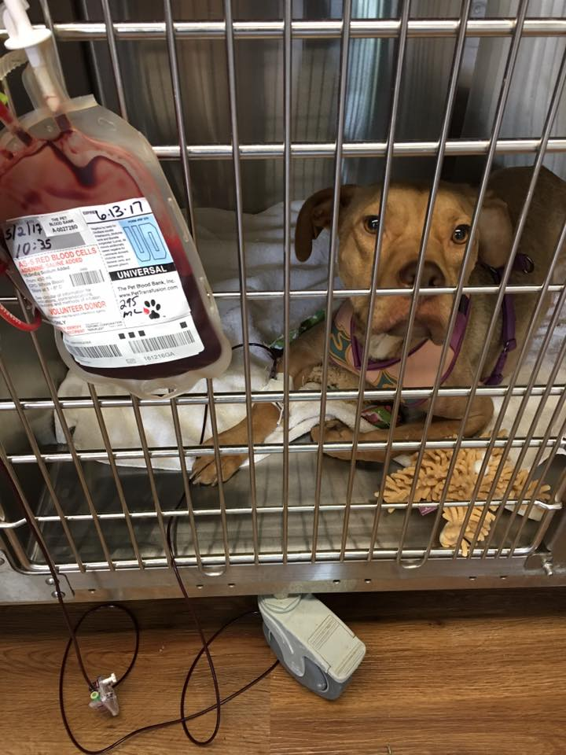
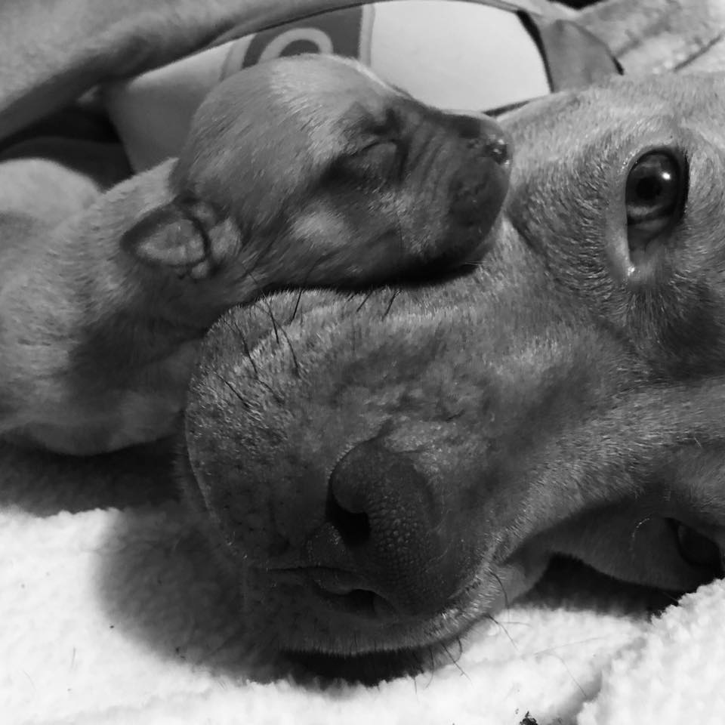

Slide 21
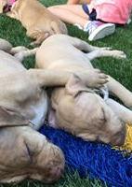
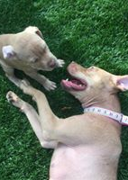
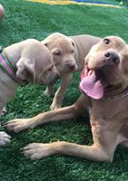
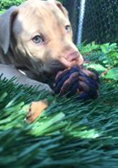
Everley is still working hard at RBARI to overcome the trauma she suffered and making progress each day. This brave momma and her babies touched the hearts of many through their media coverage, which brought in $35,597 in donations and increased our brand recognition.

Slide 22
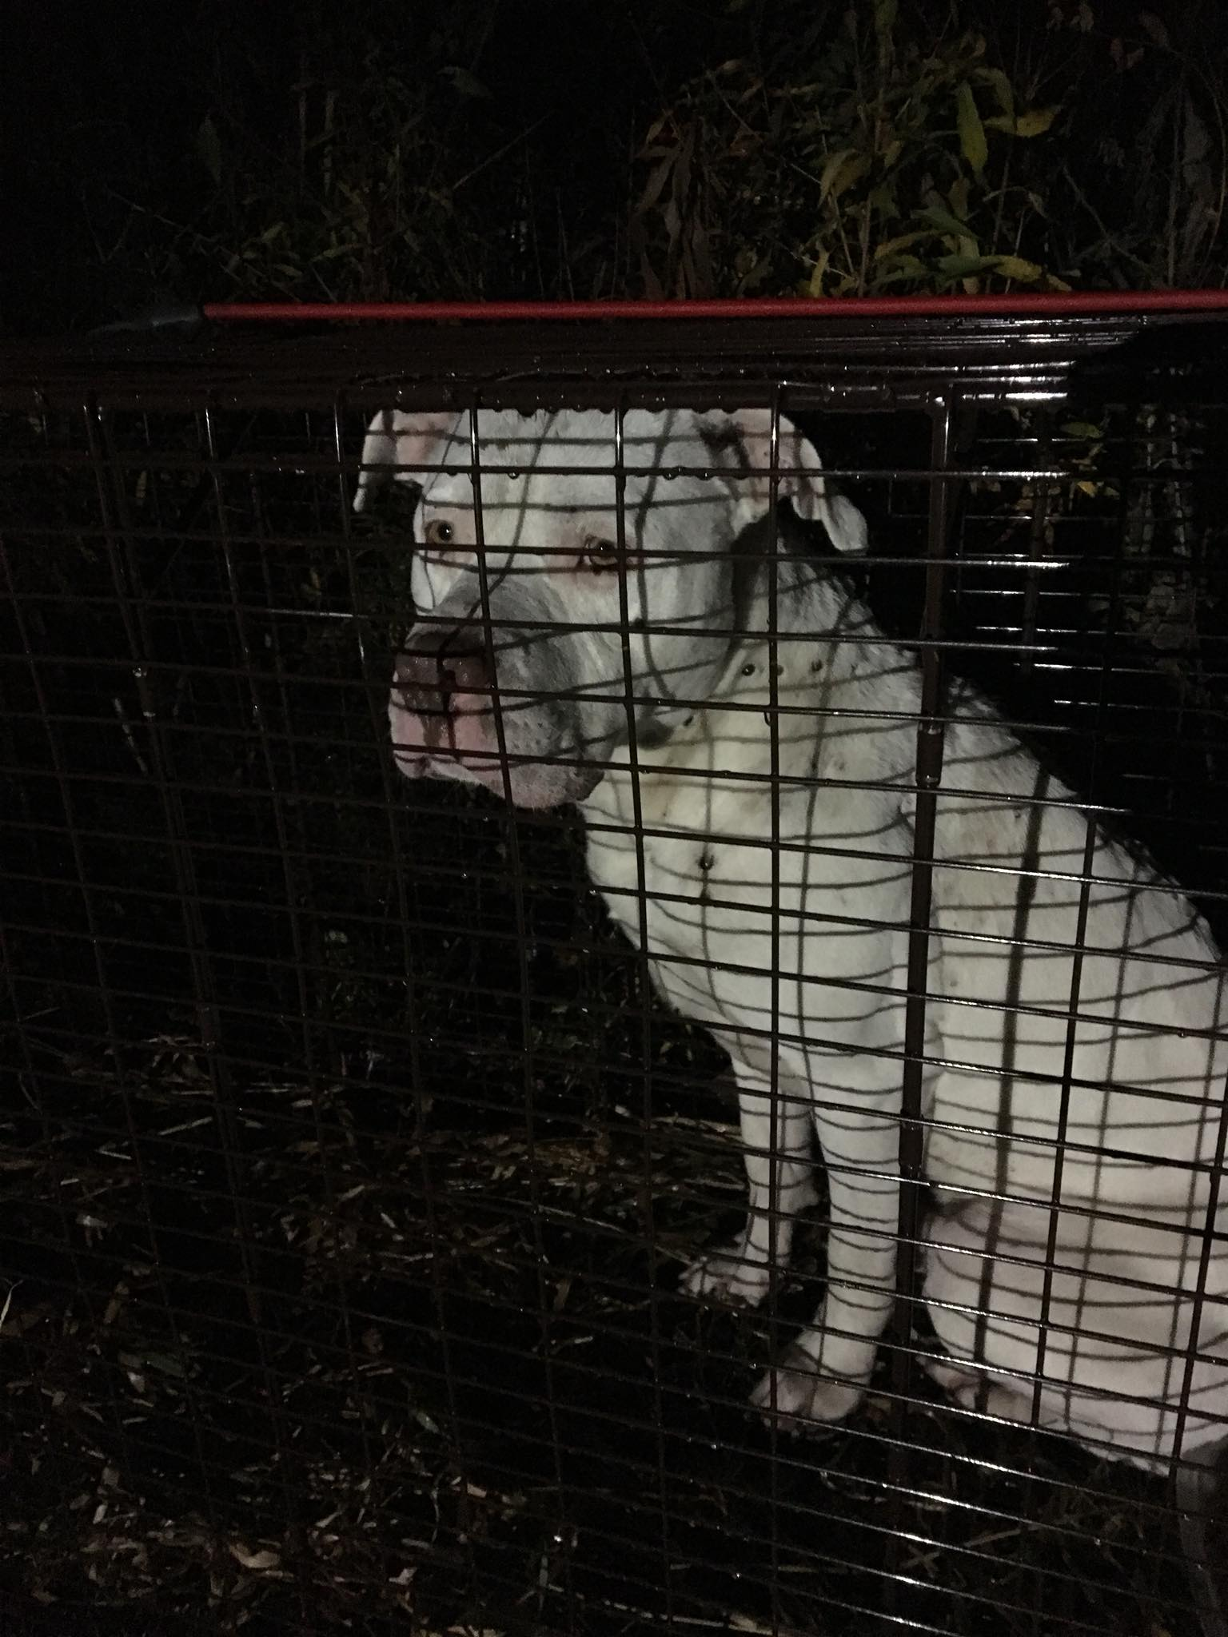
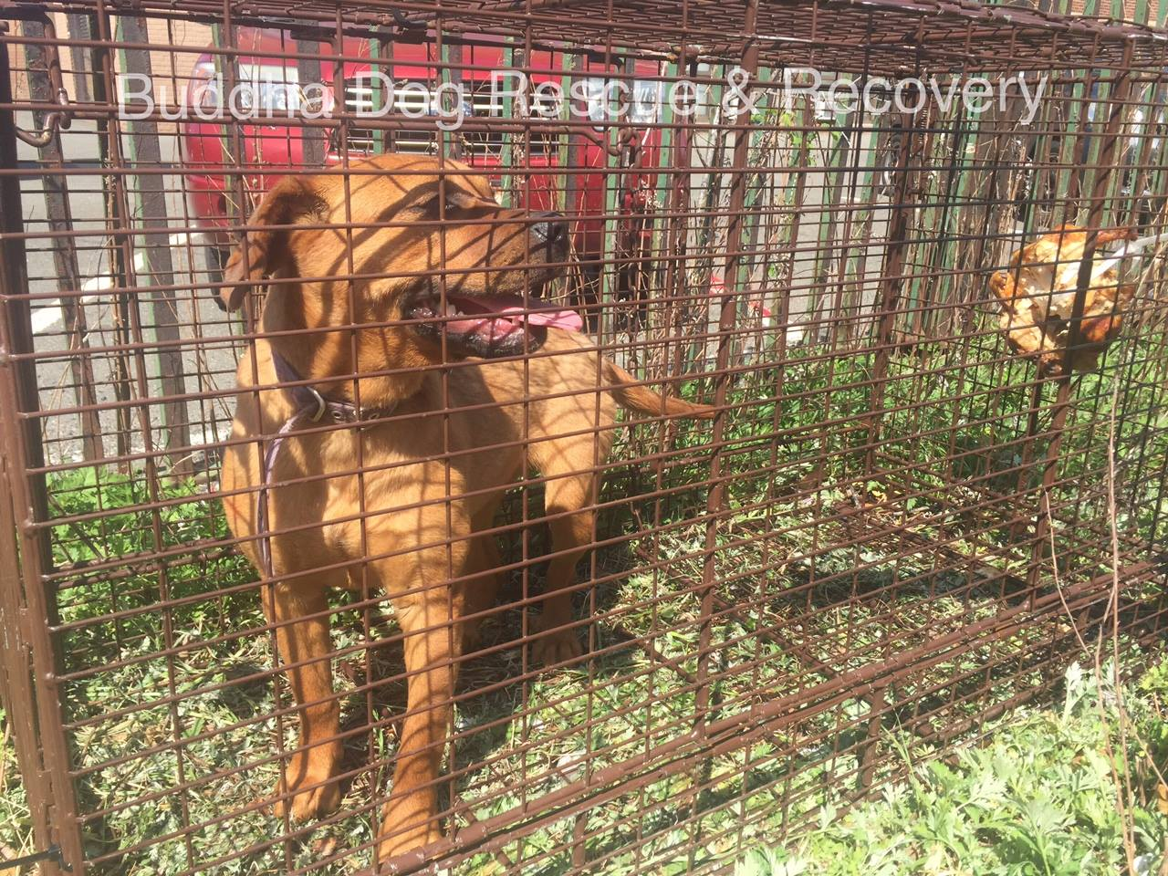
Through our partnership with Buddha Dog Rescue we have helped to save the lives of lost or abandoned dogs fighting to survive on the streets or in the woods. These powerful stories of salvation brought RBARI media coverage that helped grow RBARI’s brand, and brought in contributions to support their, and others, critical care needs.

Slide 23
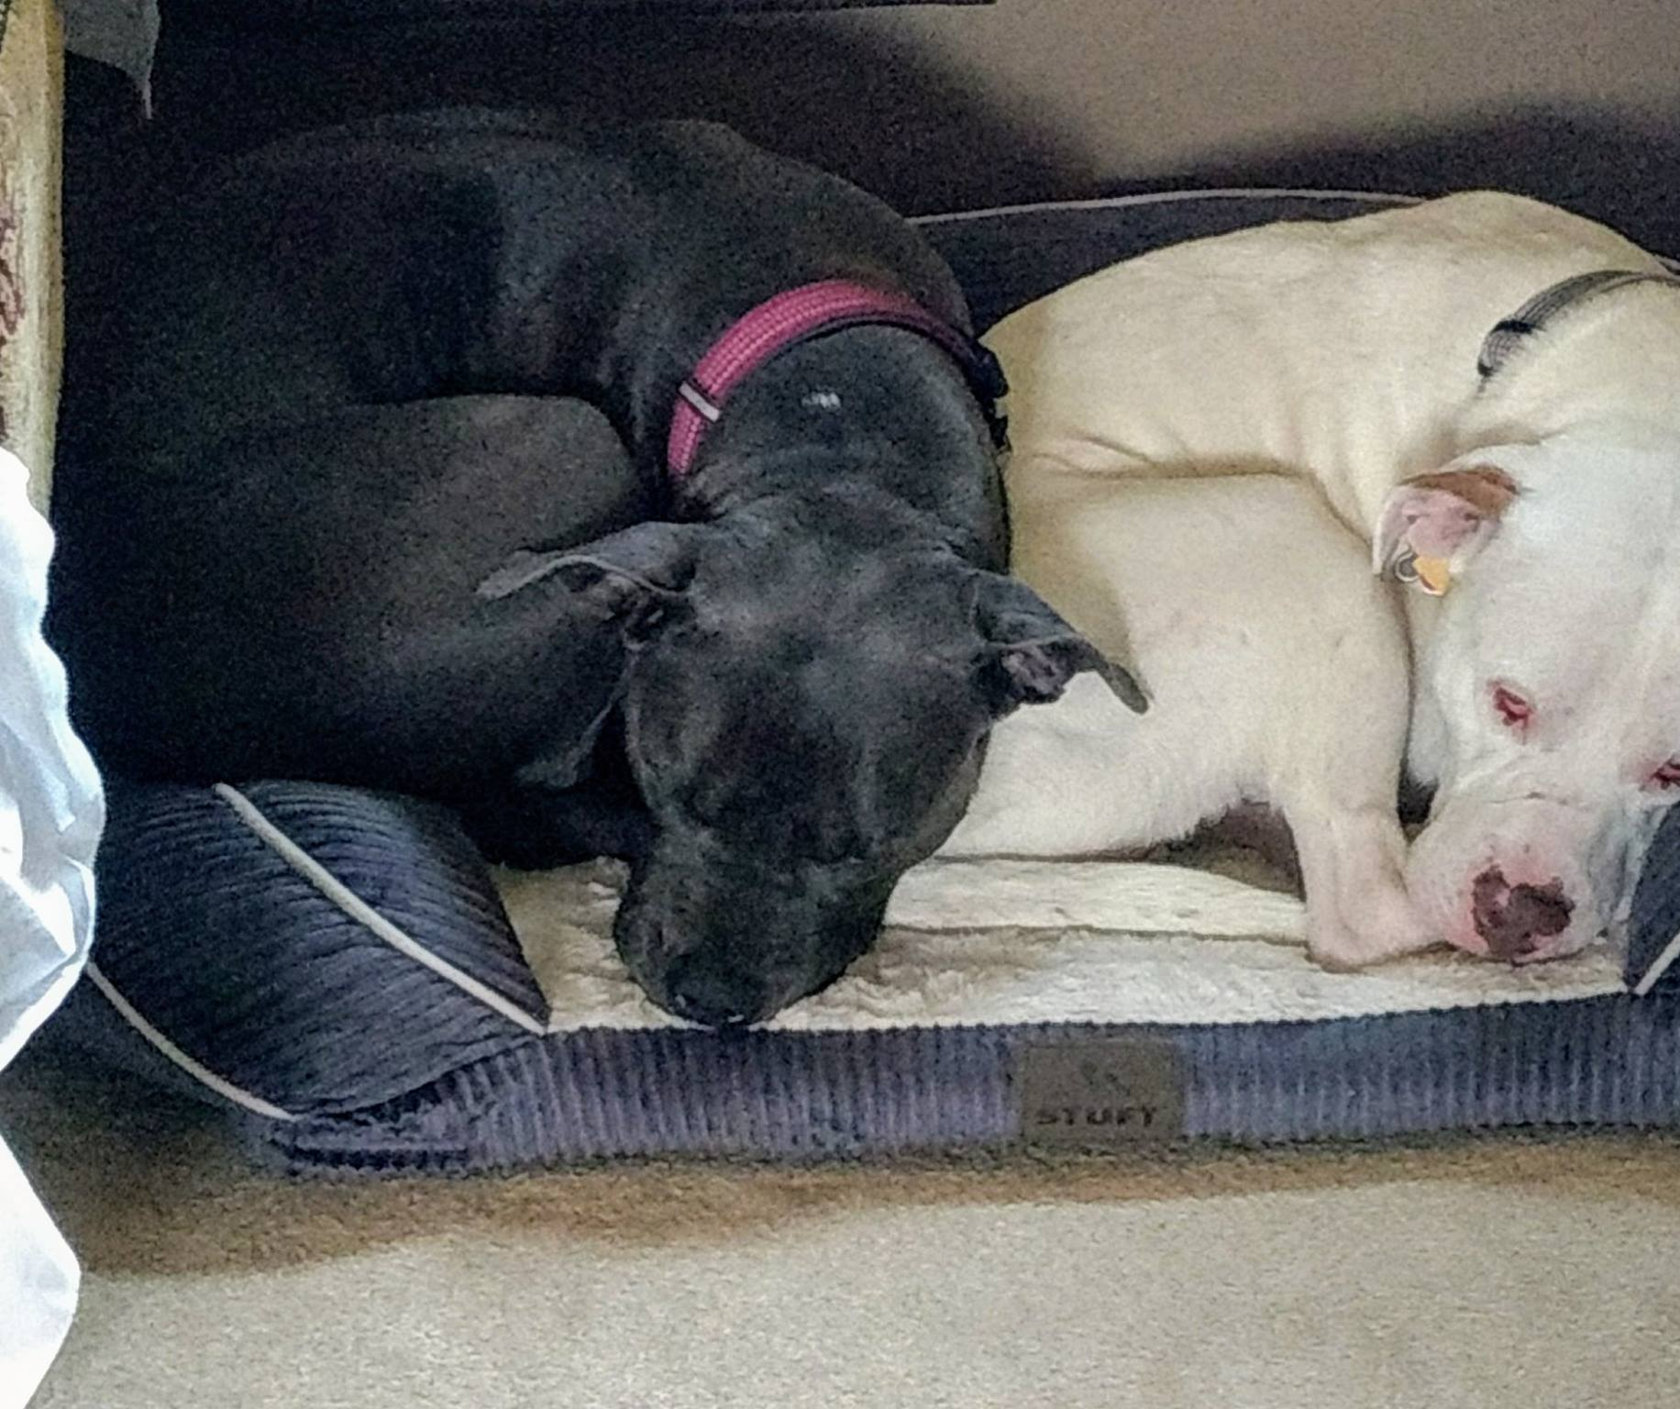
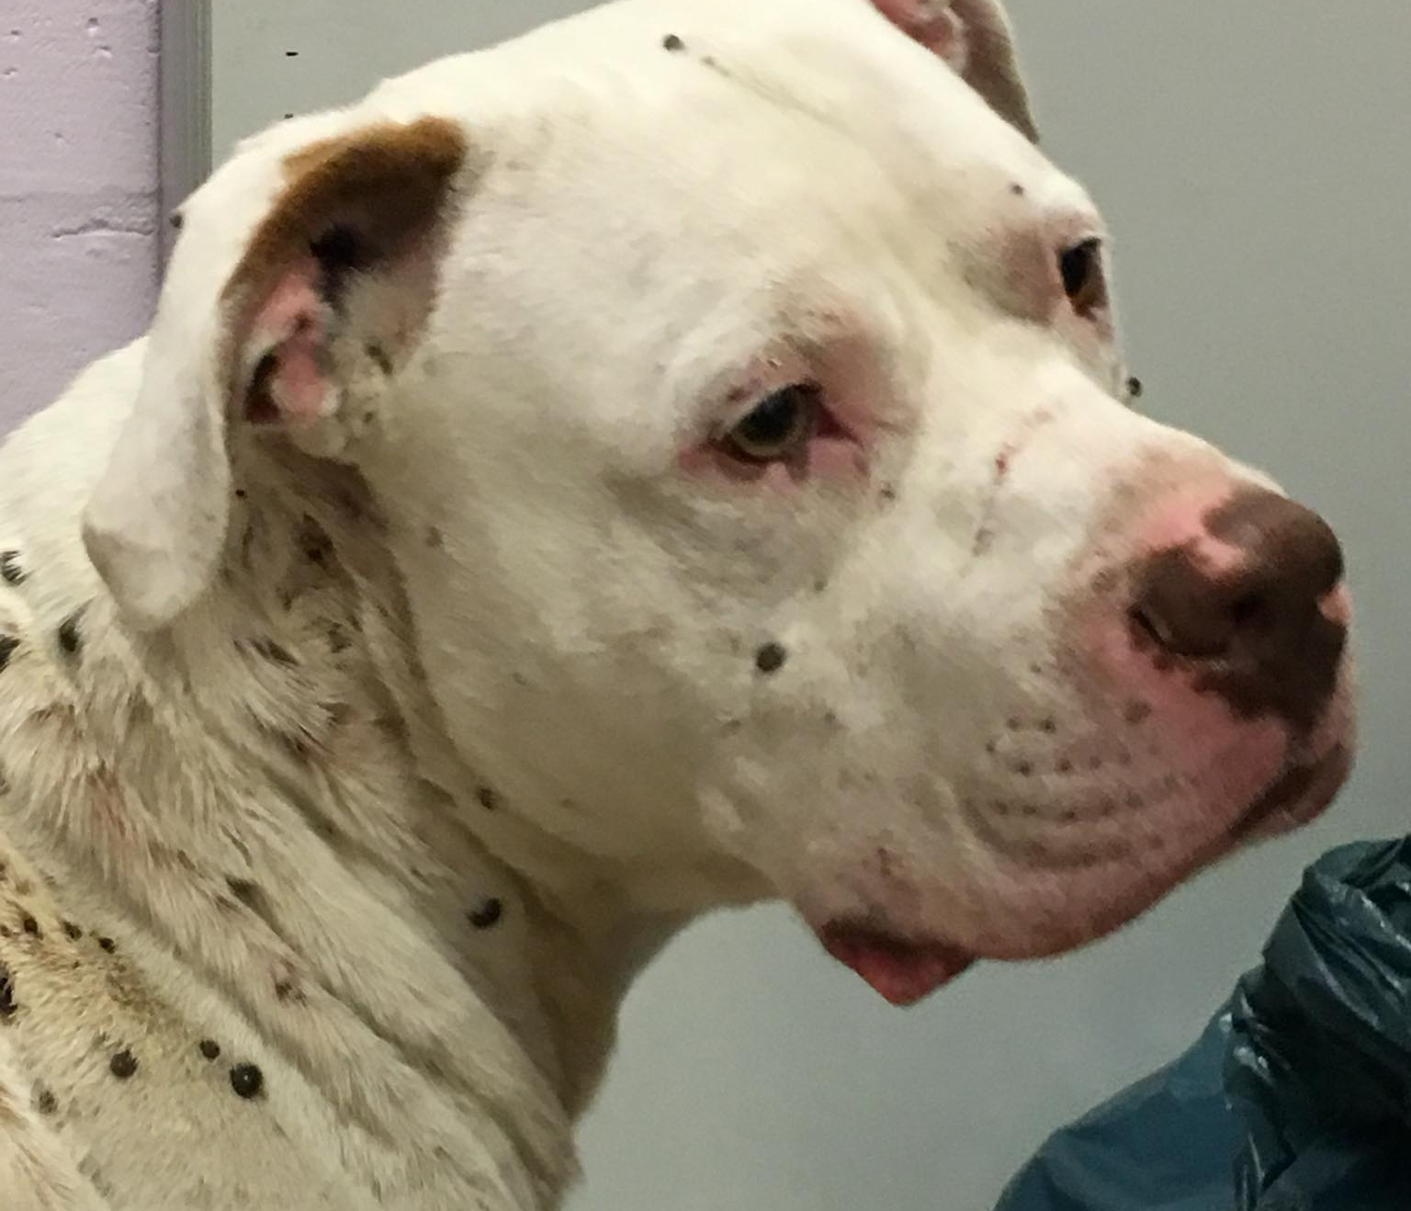
Wiley
“If an adorable dog named Wiley could speak, he would have some incredible stories to tell. Why? Because this domesticated dog lived with a wild pack of coyotes for over a year.” -Animal Channel
Wiley is now enjoying life in his forever home!

Slide 24
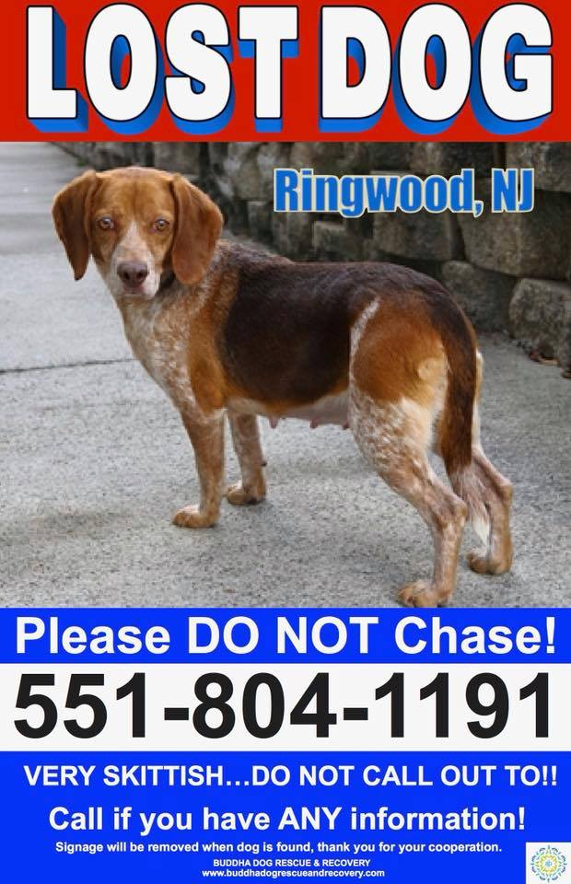
Sara & Penny
Penny came to RBARI with her companion Buster after the man who owned them passed away. Their daughter Sara had escaped from animal control and was missing. Buster was treated for his medical issues, and Penny was headed to a foster home. The day before Penny was to go to her foster home, Sara was found.
After a brief reunion, Penny left for her foster home, only to escape and go missing. RBARI partnered with Buddha Dog Rescue and Penny was found. Since then, Penny and Sara’s bound has been inseparable. This story of rescue and reunion made several news outlets, and brought new attention to RBARI.

Slide 25
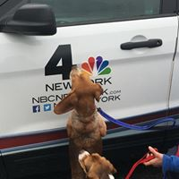
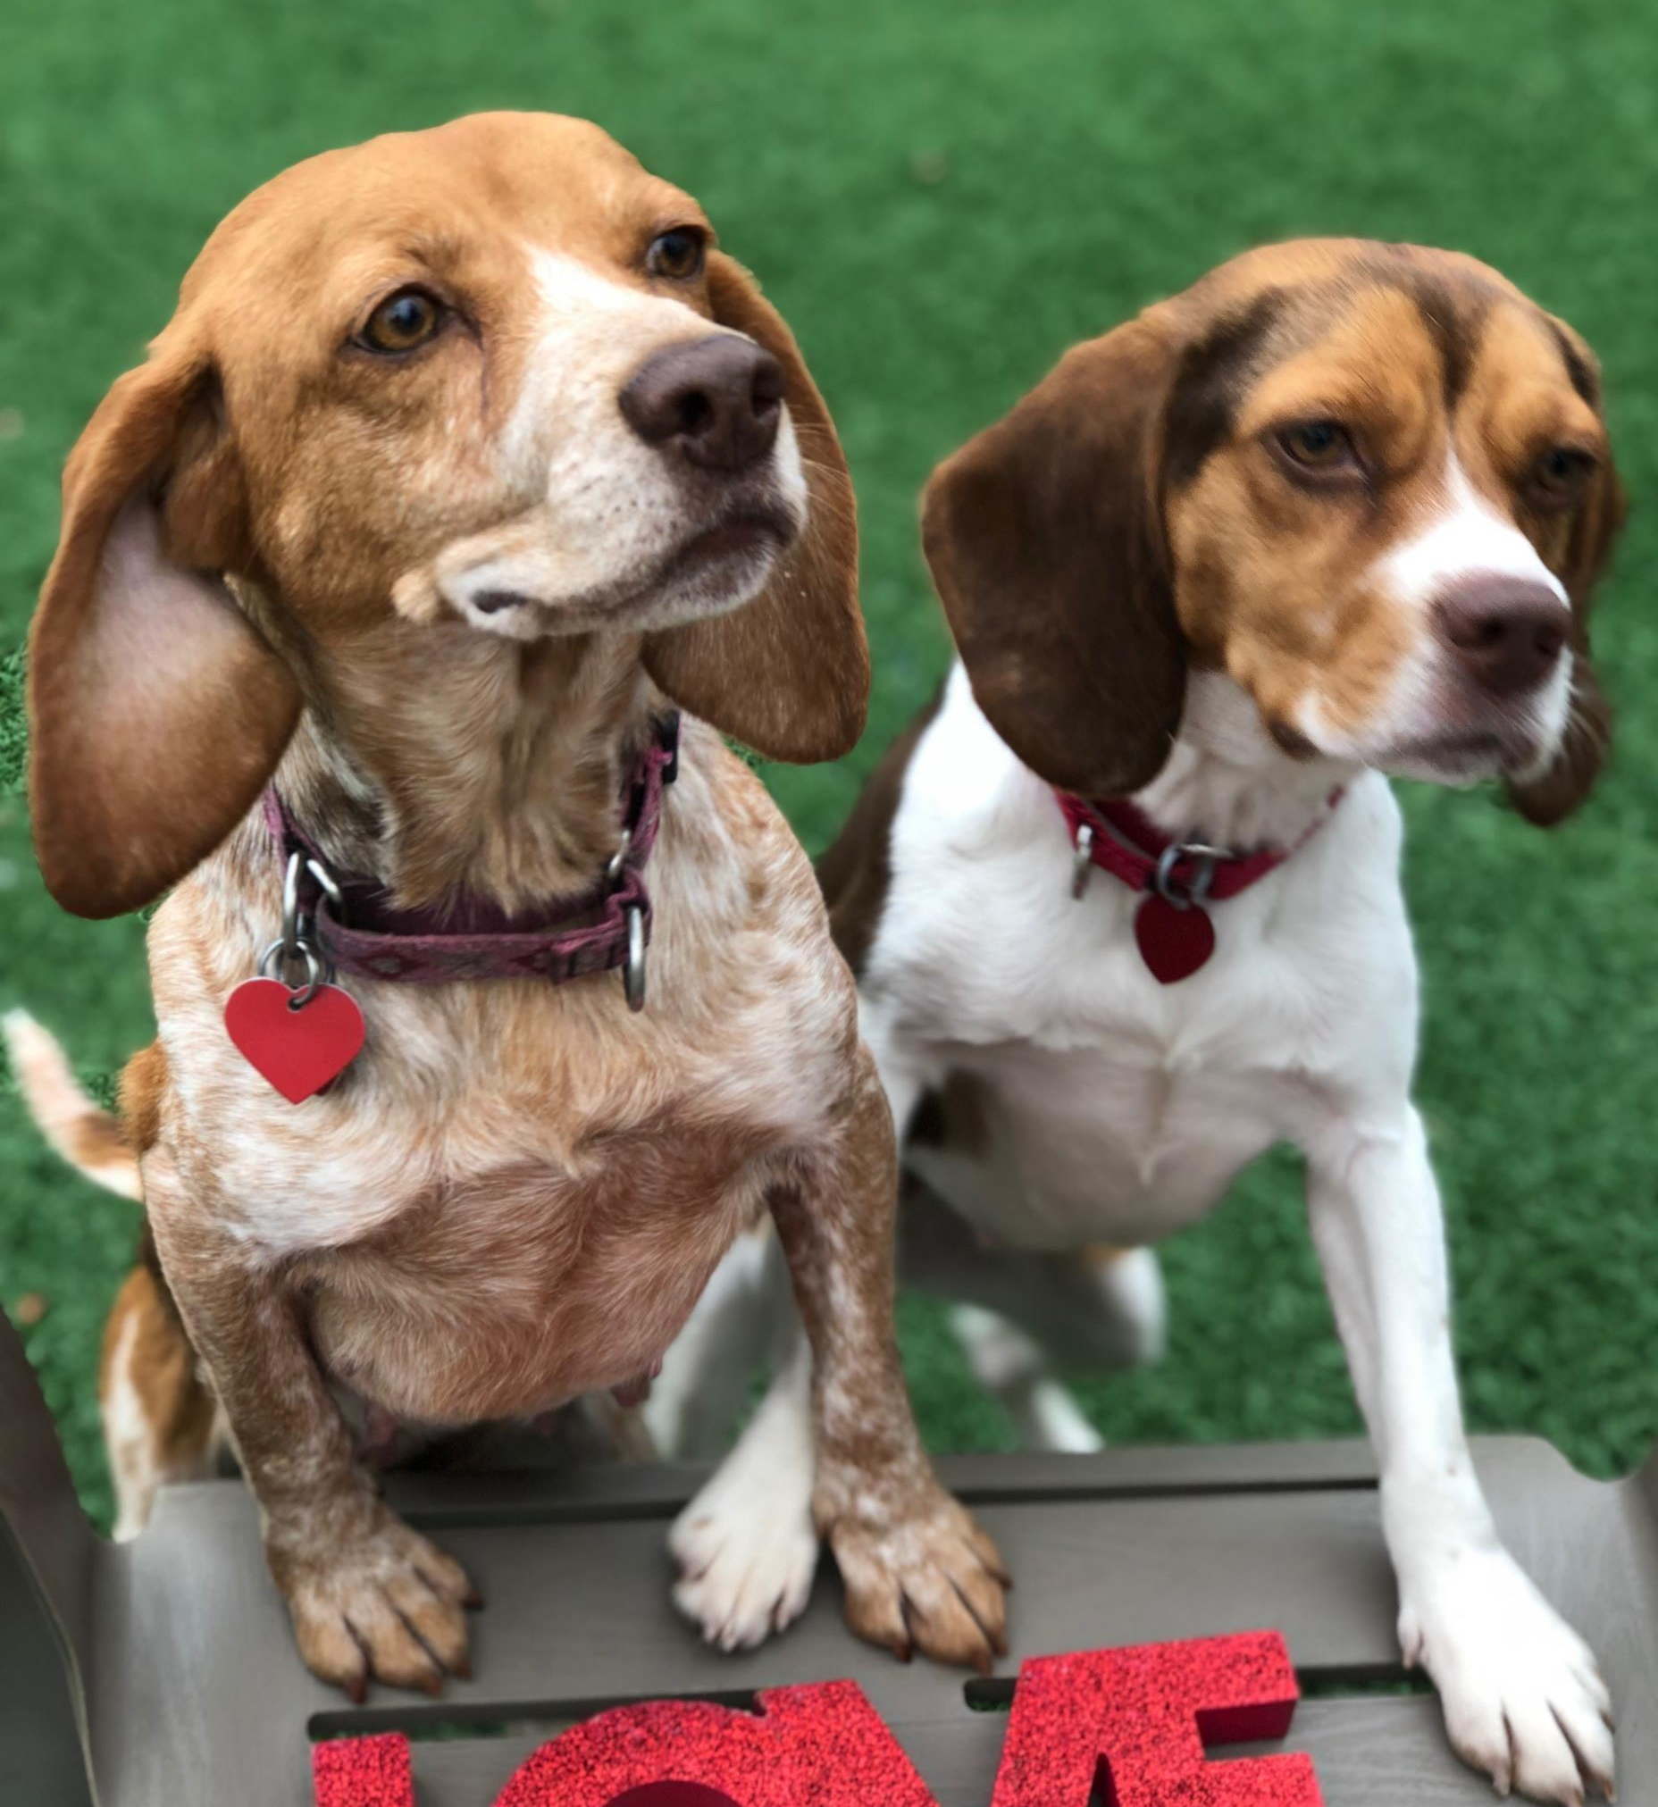

Slide 26
Buddha & Harvey – both dogs were rescued after each spent over a year outside and on their own. Their story of survival brought local and national news coverage.

Slide 27
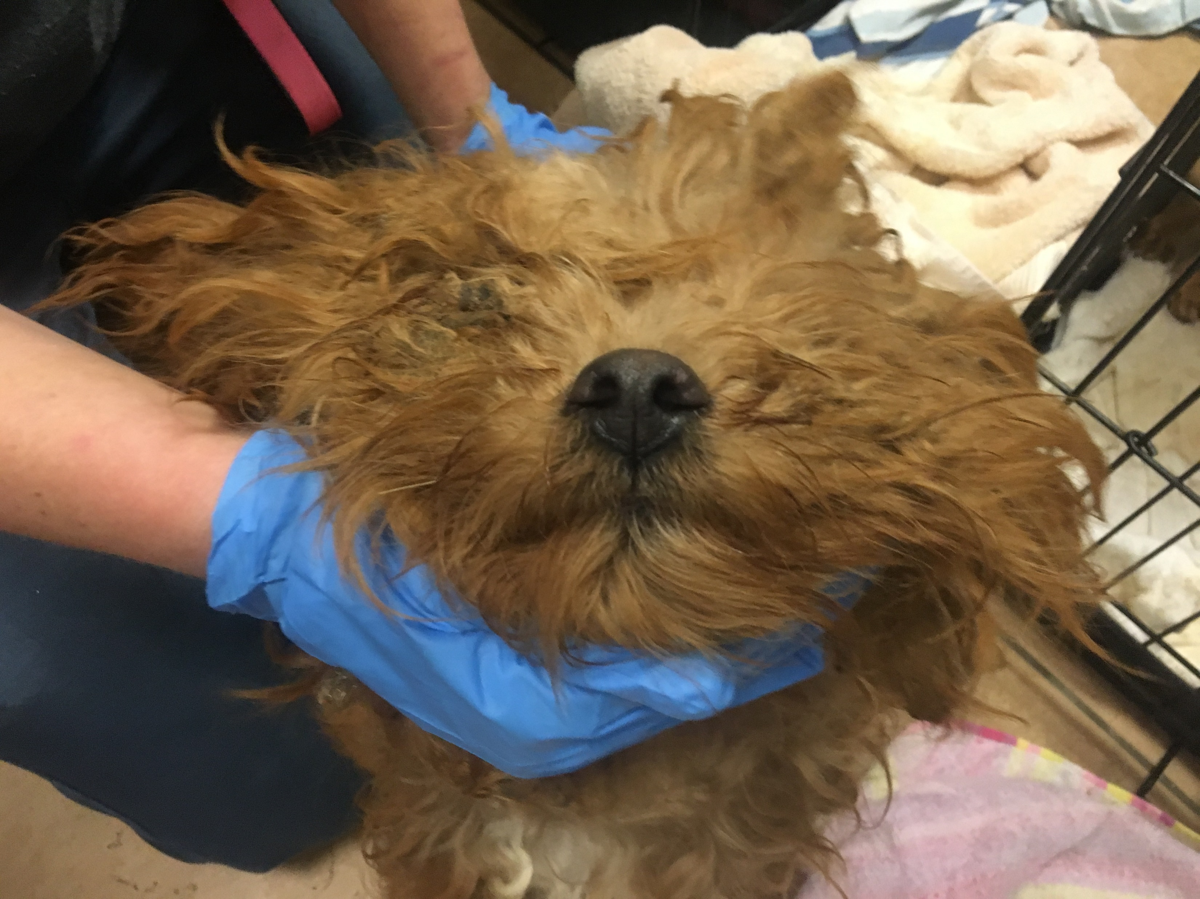
Patterson 12- PATERSON, N.J. (CBS) — A dozen neglected dogs were found in an abandoned home in Paterson on Tuesday. The Ramapo-Bergen Animal Refuge says they rescued 12 dogs after receiving a call from Paterson Animal Control and Passaic County SPCA.

Slide 28
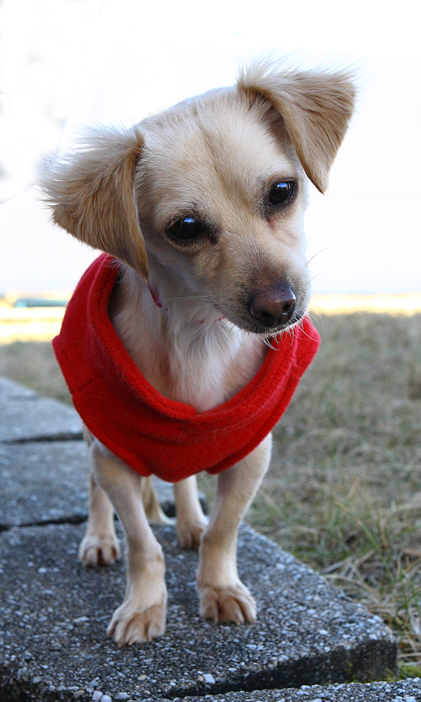
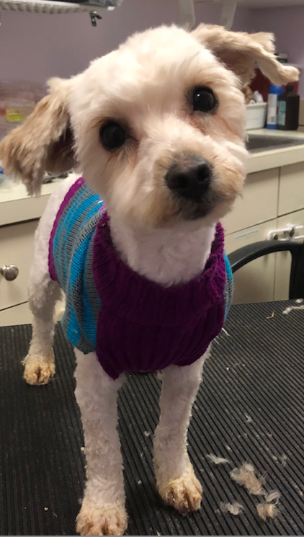
The story of these 12 captured the attention of national and local news outlets, helping to show the heart and the cost of the rescue work RBARI undertakes, and bringing in $18,228 in support.
We are thrilled to report that after life saving grooming and care, all 12 have found their forever homes.

Slide 29
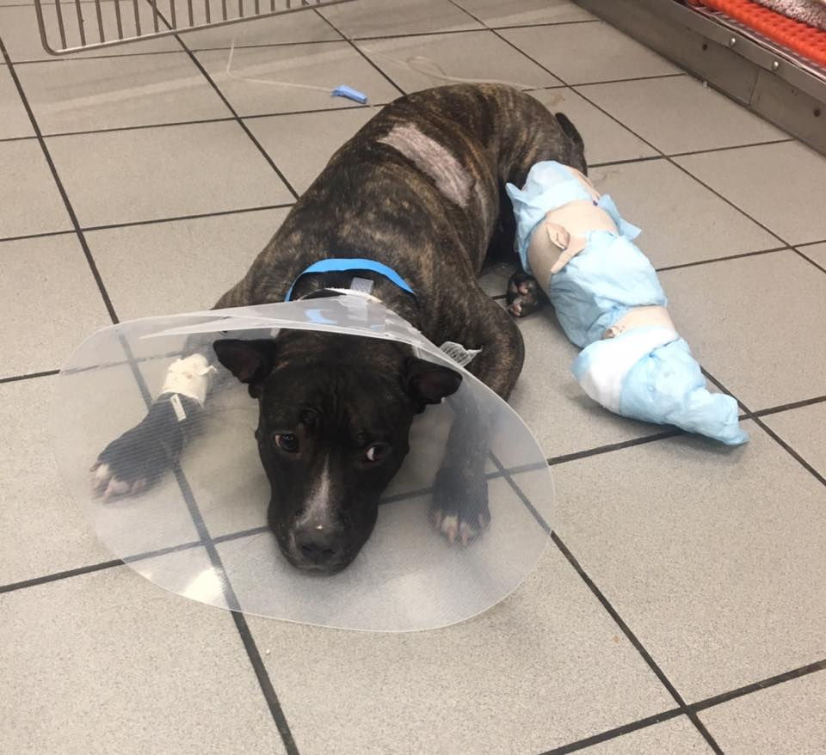
Lexi - Pit Bull Puppy Survives 5-Story Jump from Building, Shelter Needs Help Paying for Care - People.com When RBARI took in Lexi we knew we needed to get support to help with her medical care. By reaching out and sharing her story with news outlets we were able to raise close to $10,000 to help support her recovery, and gain new exposure from places like NBC news, and People.com.

Slide 30
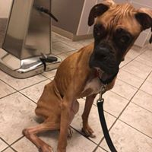
Kira - When 2-year-old Boxer Kira came to the Ramapo Bergen Animal Refuge, she was half the weight she should have been and in bad shape. Now the organization is nursing her back to health, and is asking the public's help for her medical bills. – NJ 101.5

Slide 31
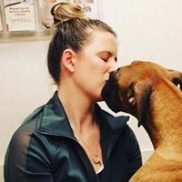
Kira is currently thriving in her foster home where she continues to gain weight and recover. Her story brought in an outpouring of support and $24,485 in donations.

Slide 32
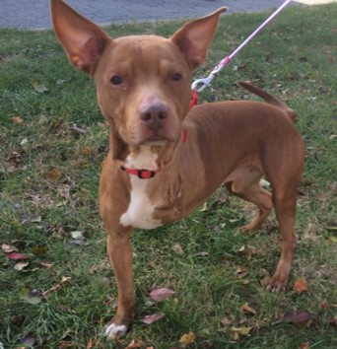
Through persistent efforts of outreach, RBARI has not only helped rescue the dogs and cats who needed us most, but these stories directly resulted in elevating our reputation, increasing our support base, and brought in new donors. All of this led to RBARI being selected as one of the 30 shelters in the US that makes America proud.
“Rescue, rehabilitation, medical care, a no-kill policy, and finding new owners – RBARI does it all.” – TopDogTips.com

Slide 33
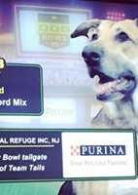
RBARI’s elevated position amongst shelters paid off big time when two of our dogs were selected to participate in Animal Planet’s Dog Bowl, a nationally aired event.

Slide 34
After the Dog Bowl, RBARI was selected to participate in another national event – Petplan’s Tournament of Tails. By utilizing our growing media contacts, mobilizing our base, and building on our outreach momentum, RBARI was able to beat out 32 other shelters across the US, including our last round of competition with a shelter that was triple our size and budget to win the tournament!

Slide 35
The results of these expanded media efforts are reflected in our data, which shows increased traffic and engagement from our community.
Compared to this time last year...
Adoptable Dogs section of the website Up from 41,758 unique visitors to 179,365 (+308%)
Home Page Up from 49,643 unique visitors to 137,688 (+177% )
Facebook traffic pulled into the website from Facebook is up from 6,939 to 18,905 unique visitors (almost every single one of our Facebook page's followers, which is at 18,963!)
Instagram traffic puled into website from the multiple accounts we run is up from 81 to 1871 unique visitors (+999%)
CBS, News 12, The Dodo, & One Green Planet articles pulled in close to 2000 unique visitors at 1823 (up from 599 from CBS alone)
Unique site visitors in the United States is up from 59,049 to 181,330 (+172%)
Facebook Up by 4,256 followers
Combined Instagram accounts Up 4,005 followers
*unique visitors = an individual visitor as opposed to a visitor returning multiple times.

Slide 36
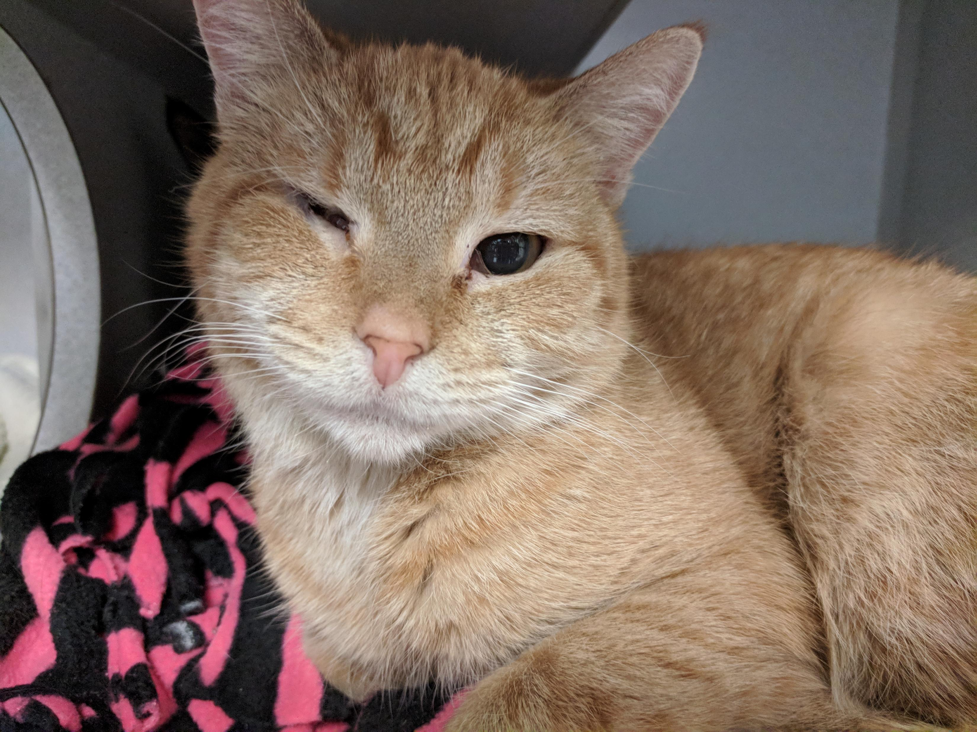
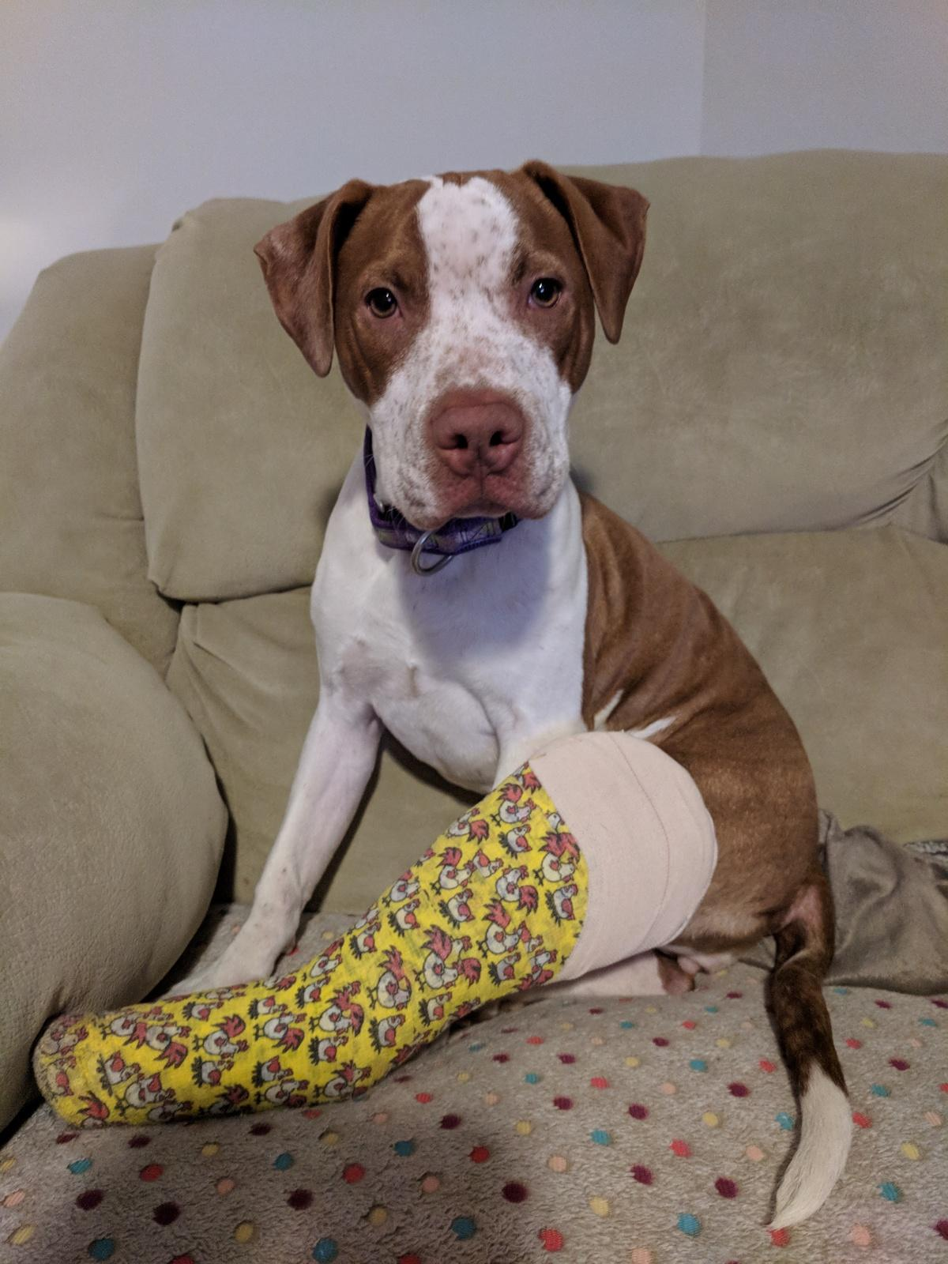
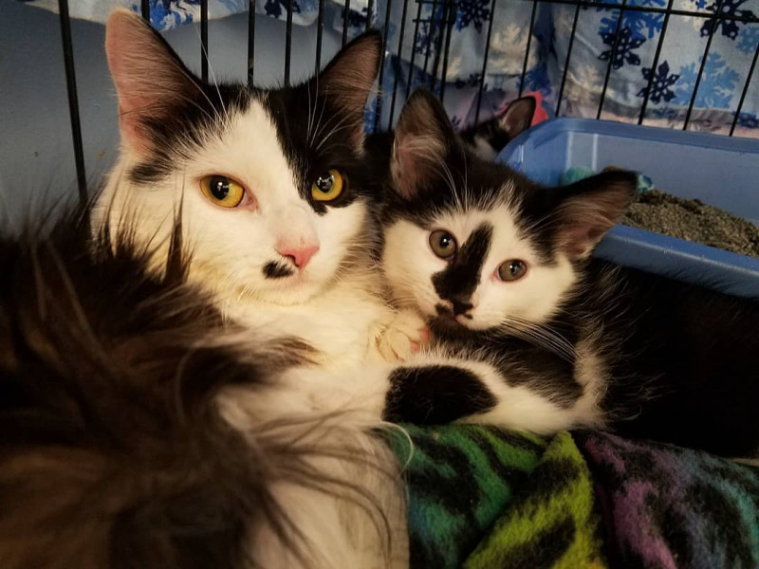
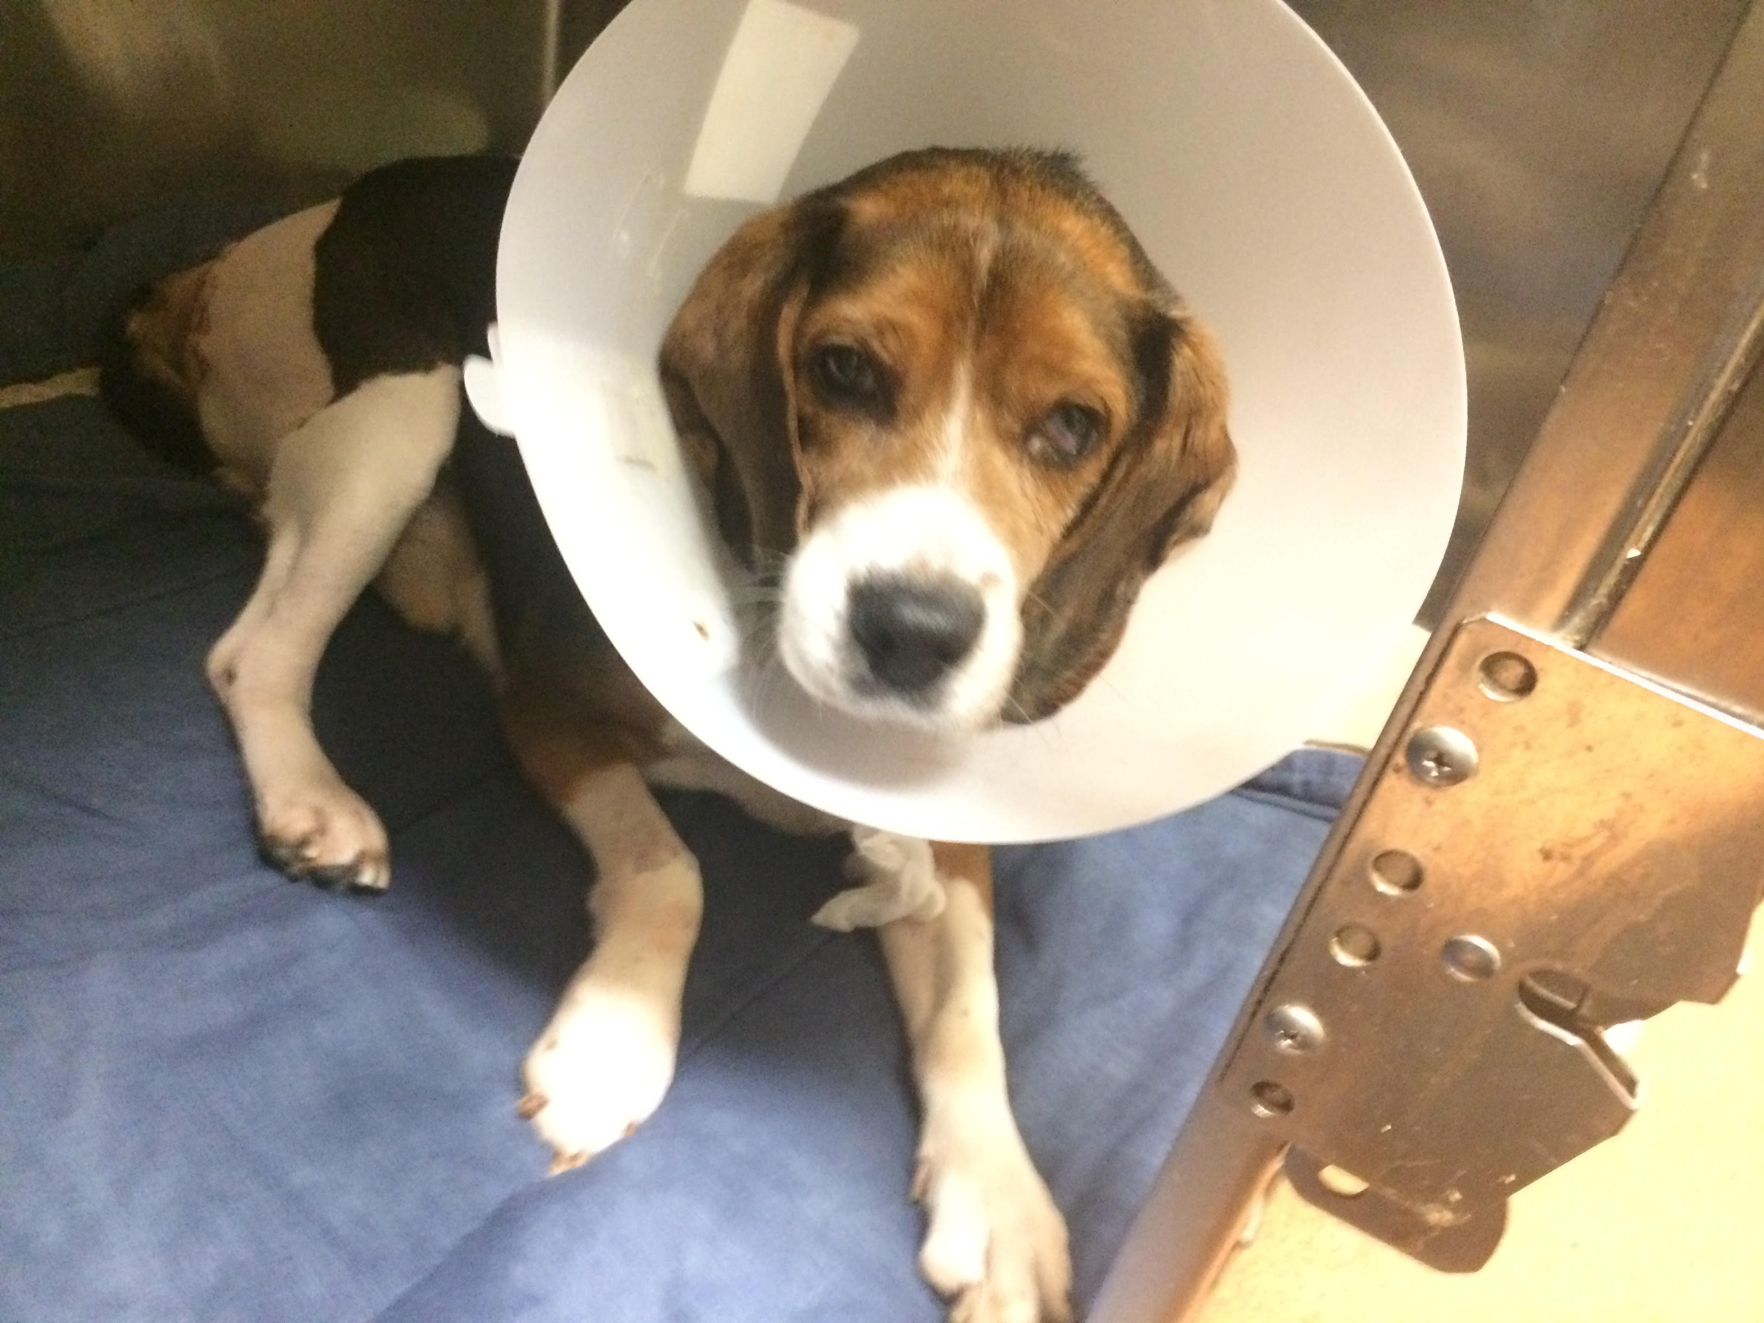
Coming full circle, the increased media exposure expanded our brand recognition and our support base thereby allowing us to take on extraordinary rescue cases. These rescue cases in turn brought in additional donations that helped to support the care of both the urgent medical cases as well as the dogs and cats we care for every day. Through our urgent medical appeals the Betty Lou Emergency Medical Fund brought in close to $143,000 in 2017. So while you might have seen Kira or Everley’s face on the appeal or in the news, they paid the generosity showed to them forward by helping others who needed us, but who might not have made the media spotlight.

Slide 37
RENOVATION:
Drawings & renovation plan submitted to the Oakland Planning Board in July, 2017. Entire plan, including 8 variances, were all approved in one meeting.
Planning Board memorialized renovation plans in August. Planning Board and Town Attorney merged RBARI’s 2 lots, incorporating the donation of land from our neighbor to enable expansion.
CAPITAL CAMPAIGN:
The latter part of November, 2017, we engaged Ruotolo Associates to perform a Pre-Capital Campaign Study for RBARI to determine feasibility of funding the project.
Two rounds of Interviews with RBARI supporters & donators have been conducted thus far with the third & final imminent.
Focus Groups involving different groups are being set up.
We anticipate having results of this study by end of June.

Slide 38
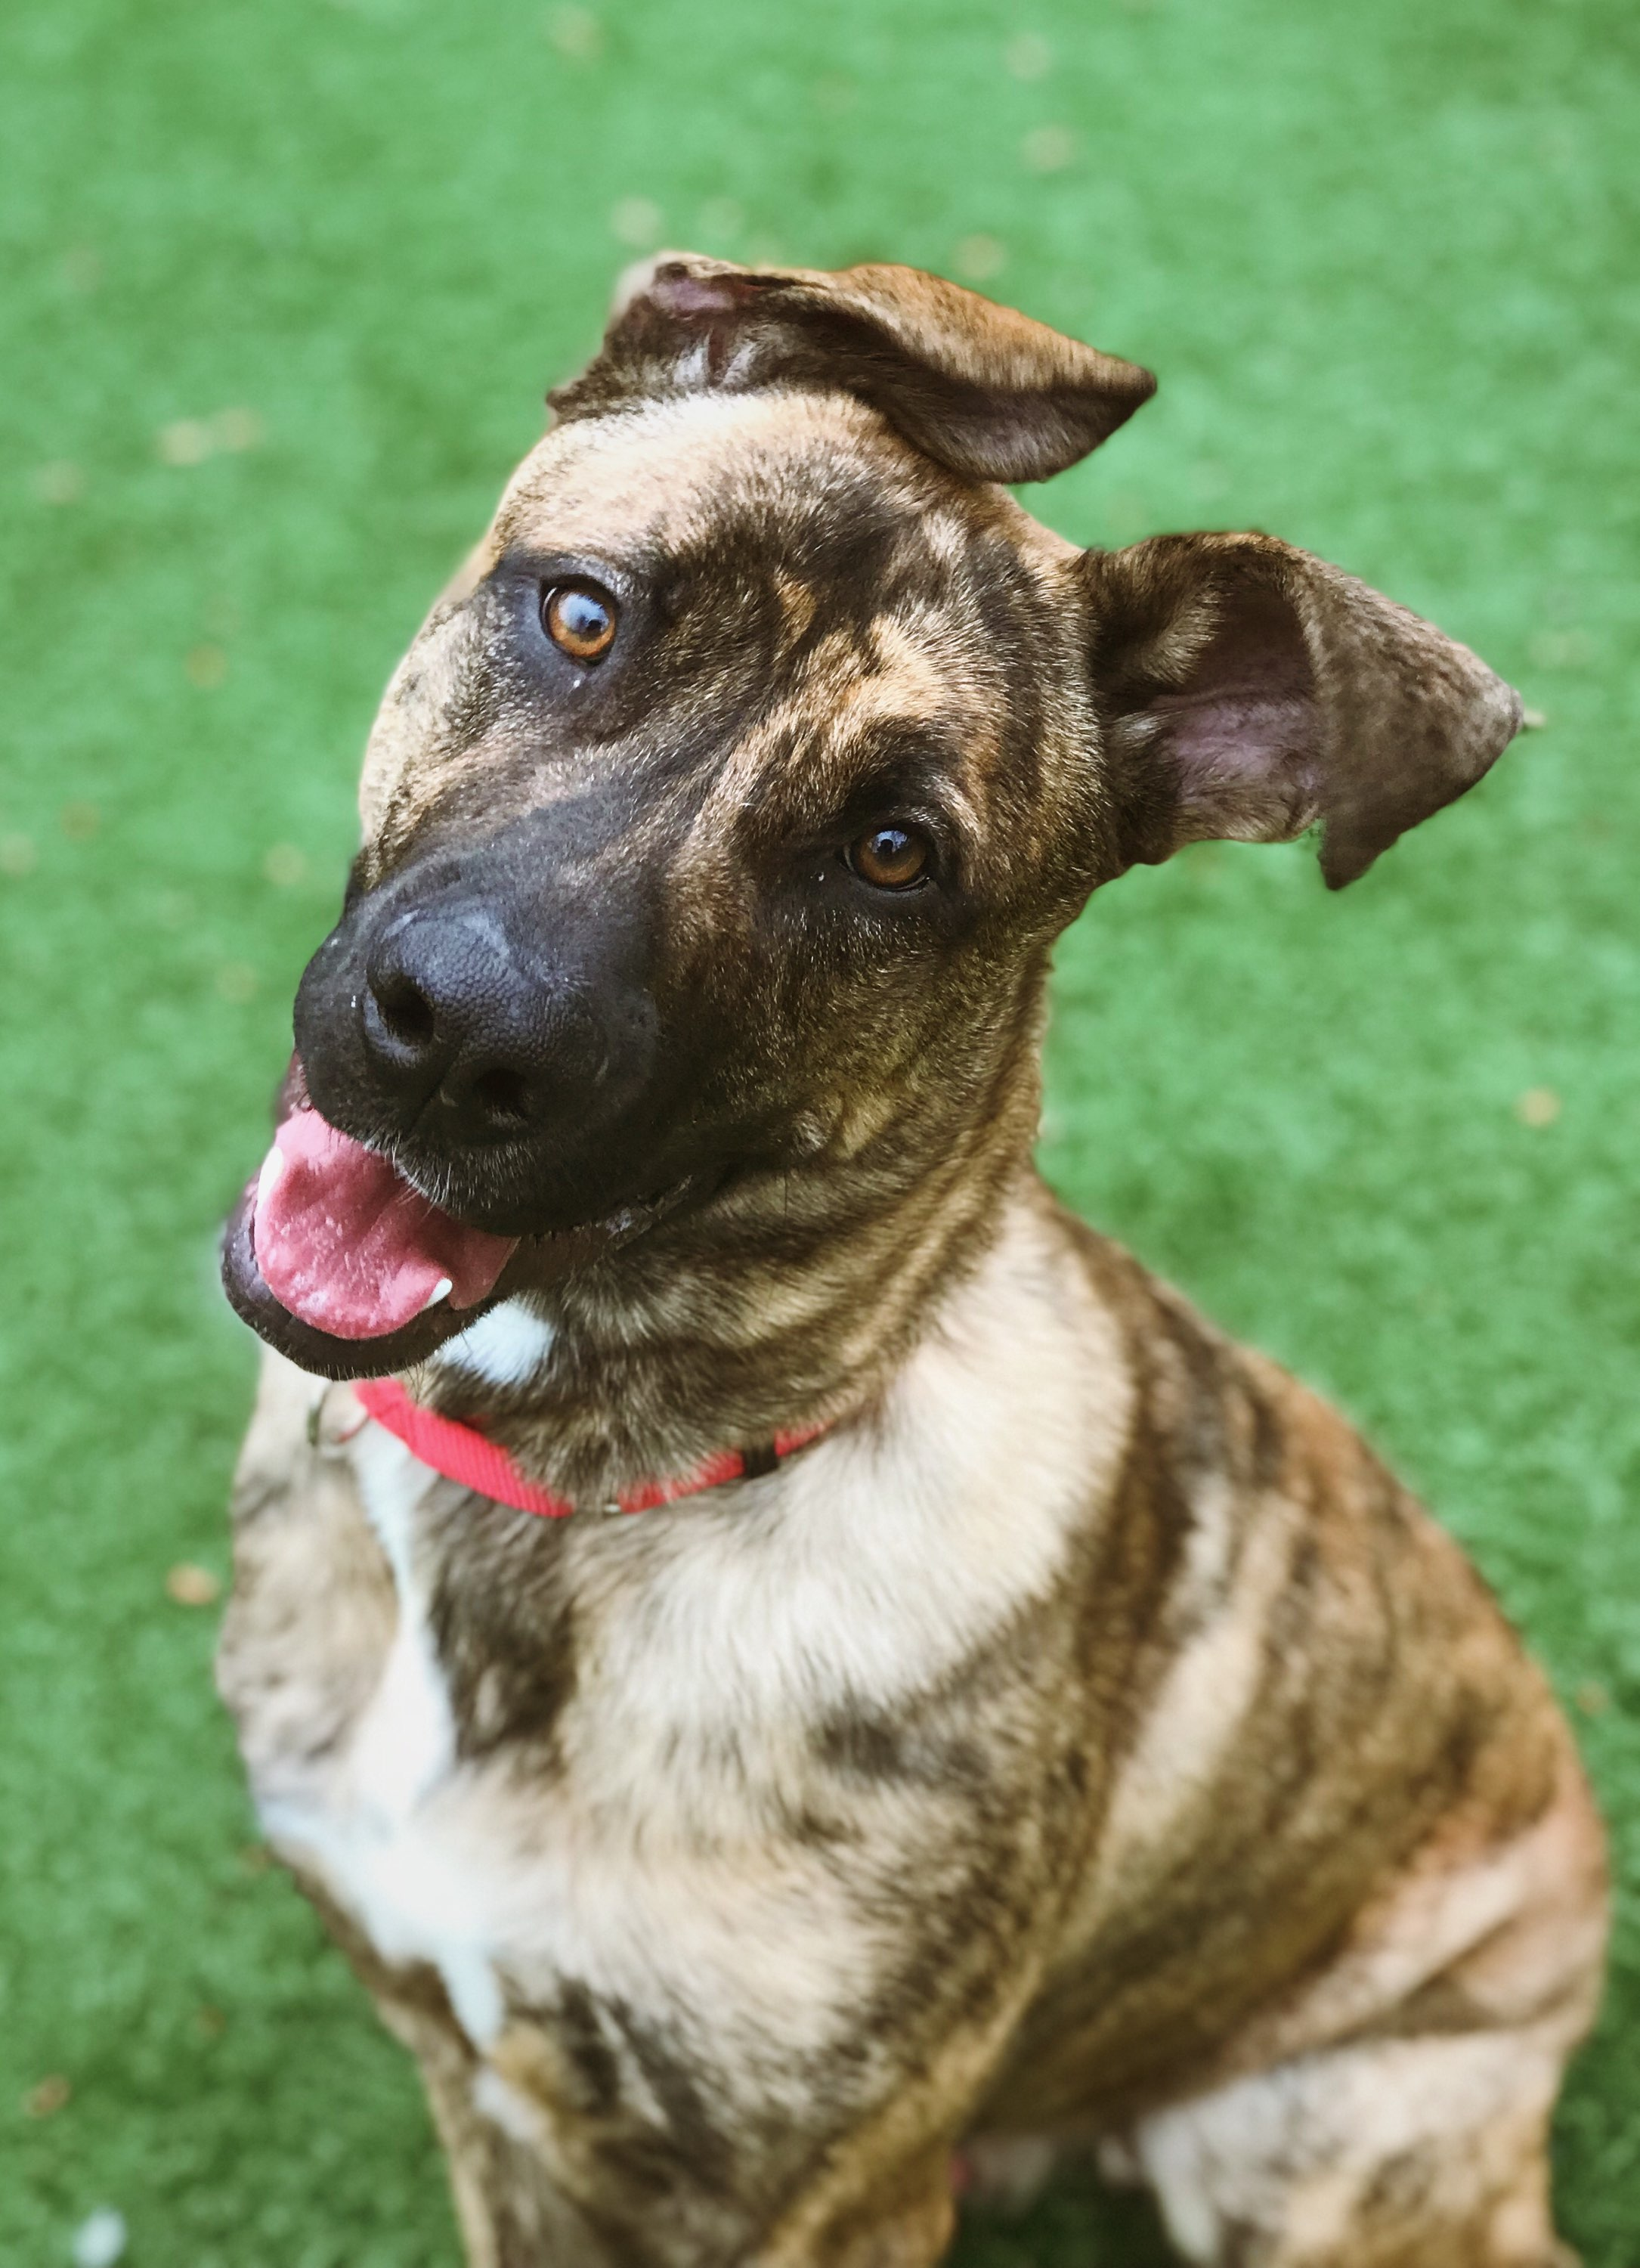
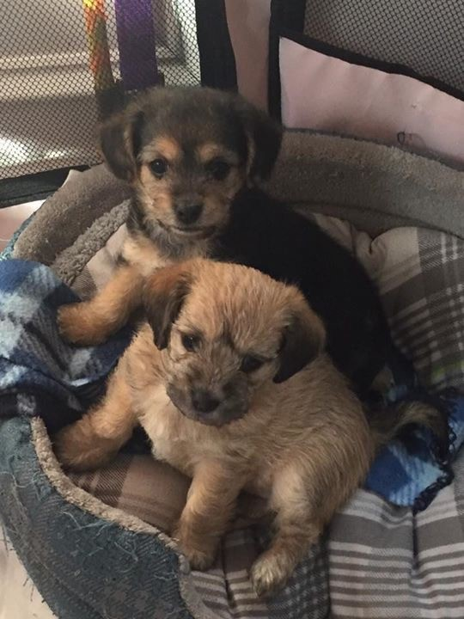
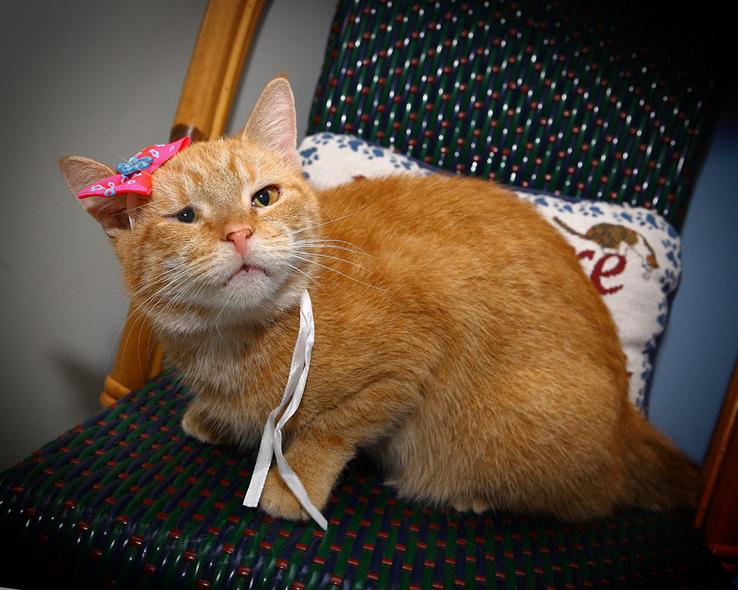
It is only by working together, and keeping our focus on what is best for those we are entrusted to care for that RBARI can continue to grow and prosper. We thank you for your commitment and dedication, and for being here for this annual meeting. Words can only go so far. We now invite you to enjoy a video of the work you made possible, and the lives you have directly helped to save.

