Slide 1
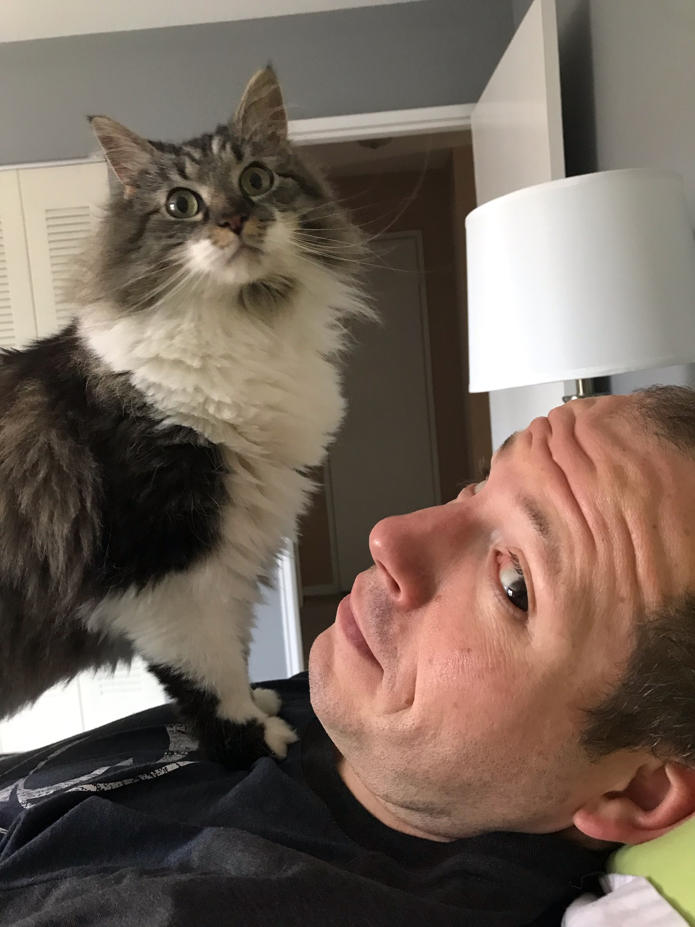
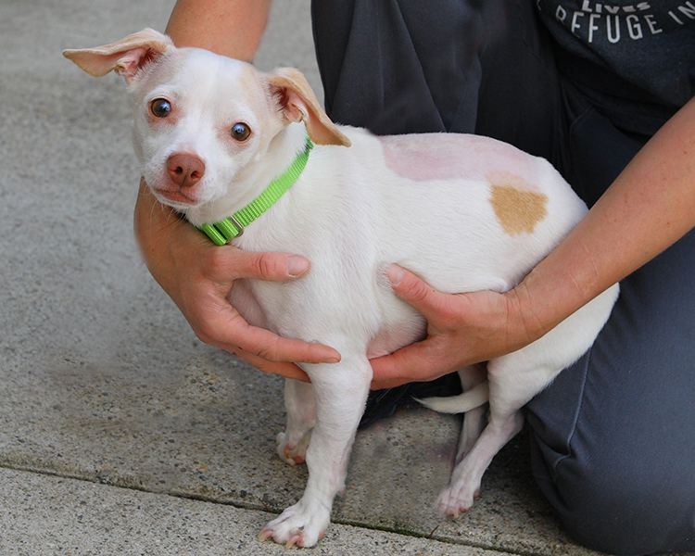
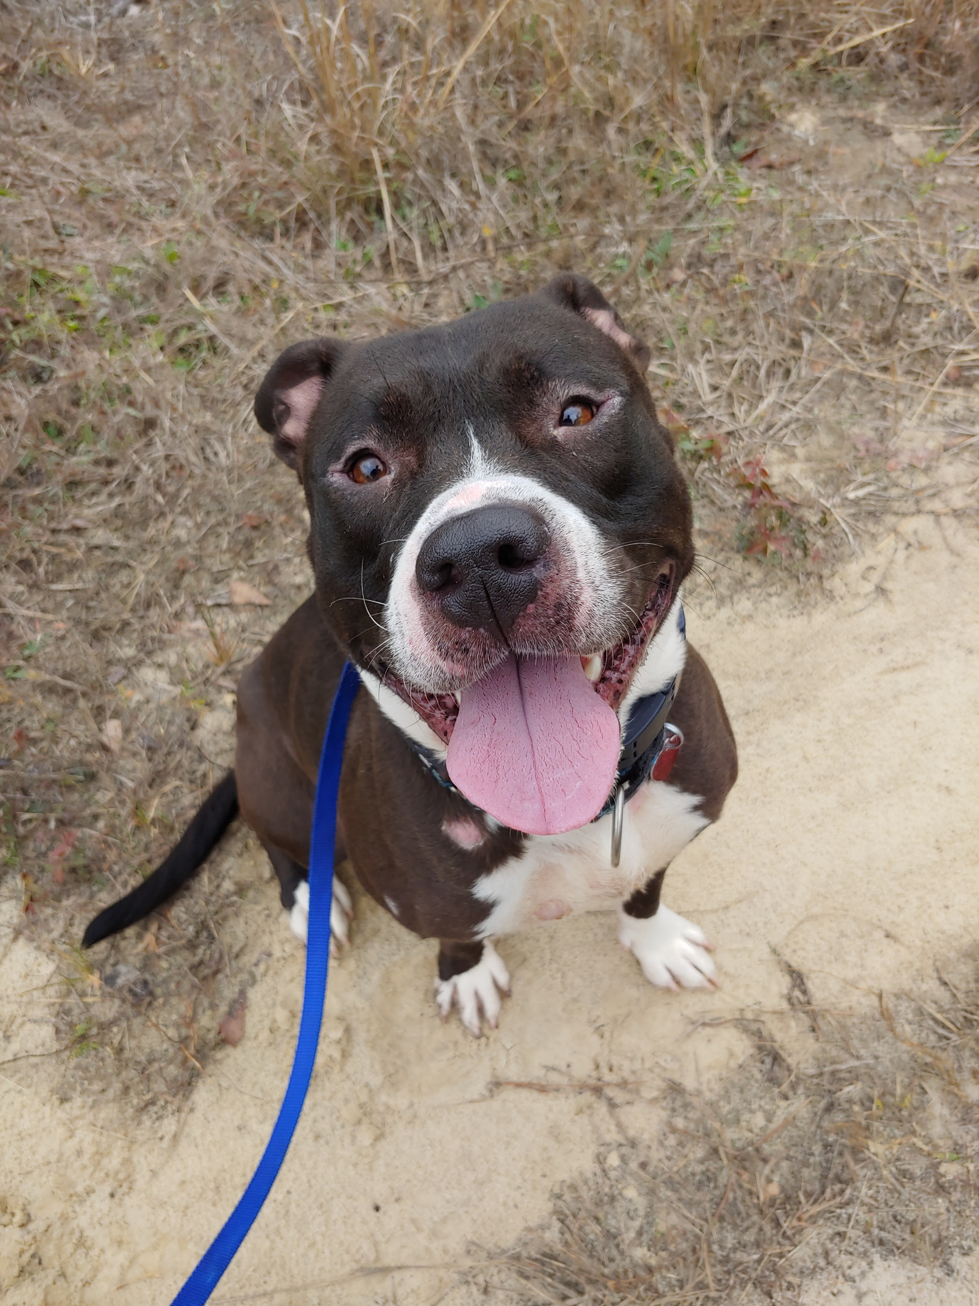

RBARI 2019 Annual Meeting
Thank you to the North Haledon Fire Co. 1 for use of the facility
Icicle
Woody
Paterson

Slide 4
Ensuring RBARI’s Future
Expense reduction and monitoring
Monitoring our intake of animals with the goal of adopting out animals faster. Intake is focused on highly adoptable dogs and cats that will have a shorter stay at the shelter, thereby allowing us to help more dogs and cats overall, without taxing our budget.
Holding regular welfare meetings to review animal needs, medical care and ensuring we are using vets and animal hospitals as efficiently as possible, while maintaining a consistent high quality care.
Consolidating ordering to ensure costs are kept as low as possible. This includes re-negotiating with vendors, entering into collaborations with providers to get better deals, and seeking sponsorship from those who we purchase from.
Reviewing finances regularly with close attention to spending trends and revenue coming in.
Reinvesting in our volunteer program through the addition of a volunteer coordinator to help offset costs with the use of volunteer aid.

Slide 5
Investments
We have invested bequest money into interest-yielding low risk money market accounts. This will help generate a consistent and new source of income for RBARI. As we are able to increase donations, we can continue to invest bequest money into these accounts, thereby increasing the amount of interest we earn.
Monthly Donations
We are steadily increasing our number of monthly recurring donations, and expanding our monthly donor program through the following methods:
Sending out regular appeals aimed at soliciting monthly donors.
Creating a RBARI Rescue Hero Sustaining Member category and program to encourage support of $50 or more a month.
Revamping the monthly donation section of the website.
Deploying a pop-up ad on the website asking for monthly donations.
Asking our past adopters to pay it forward and become a monthly donor to help support dogs and cats still at the shelter.

Slide 6
Grants and Foundations
We are seeking and receiving additional grant and foundation funding. This includes:
Researching new foundations.
Creating Proposal Outlines in different areas (Pit Stop, Community Cats, Training, etc.) to allow for consistent language that makes the submission of grants more efficient. With stable staffing and programming, this process will be more effective.
Sending out consistent communication and follow up.
Engaging with and speaking to more local foundations.
Seeking greater support for medical cases.
Revamping and seeking corporate sponsorships.
Bequests and Estate Planning
Adding website page, and information to make estate planning and legacy giving easier.
Expanding our trust and legacy programs to include programs for animals whose owner predecease them; endowment giving; naming opportunities; and easy templates to make RBARI the beneficiary of insurance polices and investment accounts.

Slide 7
Expansion of Donor Base
We are continuing to grow our donor base through news recognition, continuity of direct mailings, exposure on national events (such as the Dog Bowl on Animal Planet), and through targeted marketing. We are also expanding donor outreach and stewardship by implementing more direct and personalized donor communication. This includes:
Sharing our post adoption stories.
Sending personalized thank yous and acknowledgments to those who give to our appeals.
Calling donors who give in larger amounts.
Scheduling more donor meetings and in-person conversations.
Holding donor appreciation events at and near the shelter.
Sending out regular email blasts highlighting fundraising needs, progress updates and our best work.
Coordinating fundraising appeals on social media, the website, and email blasts to leverage exposure. Focusing on asking others to share our content.
Social Media fundraisers are being used to engage our community and ask them to share our posts to expand our donor base.
Gofundme campaigns are being used to help bring in new donors from that platform.

Slide 8
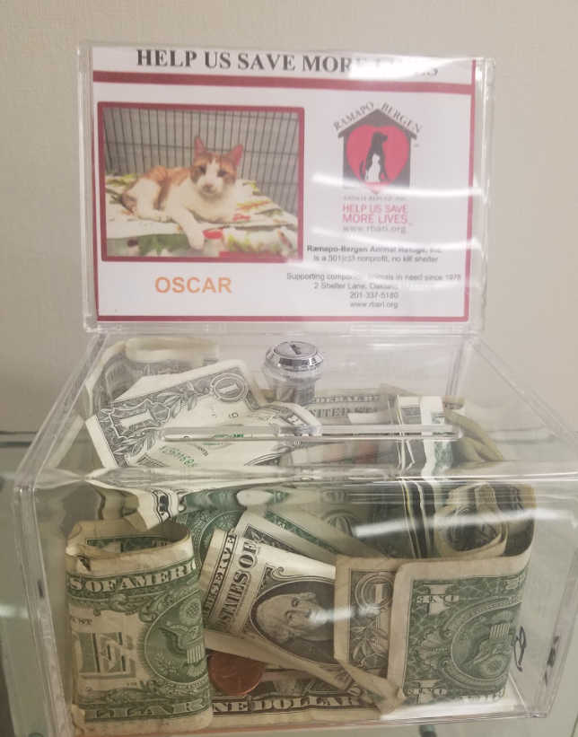

ONE LITTLE BOX
MAKING A BIG CONTRIBUTION
RBARI Cash Boxes raised nearly $10,000 in 2018 – nearly a 50% INCREASE over 2017!
Thank You Janet Gandolfo
for driving the team that helps support
the care of our animals!

Slide 9
Food Donations
We have invested in proper food storage that will enable us to hold food donation drives. This will help to cut food expenses and reduce our spending.
Events
We have made significant efforts to increase fundraising revenue, including making specific events more profitable by cutting expenses, and increasing crowd appeal.
We are revamping fundraisers to appeal to a broader audience and will be expanding our Pit Bulls & Pumpkins festival, as well as doing proactive planning in advance of events such as Strut Your Mutt to ensure fundraising efforts are fully maximized.
We will be creating a 3rd party event program, making it easy for others to help fundraise for us by offering templated programs and collateral with easy-to-follow guidelines. And, we will look to increase accountability from those seeking to partner with RBARI. This is an updated section on our website and being worked into our volunteer program as well.

Slide 10
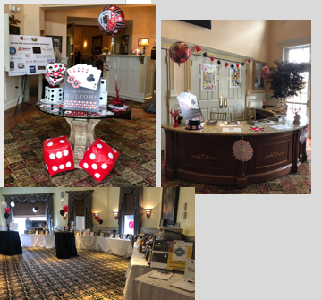
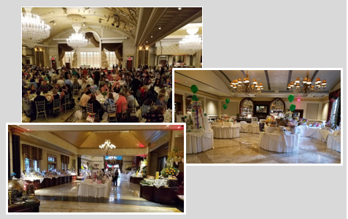
FUNDRAISING EVENTS – GO BIG OR GO HOME! 2018 – Sell-out events and a milestone celebration!
TRICKY TRAY – 20th ANNIVERSARY
CASINO NIGHT
Over 200 guests – expanded to two floors!
SOLD OUT!
SOLD OUT!
Net profit: $32,000 – an 85% increase over 2017!
A bigger, better, more upscale venue –
The Venetian, Garfield, garnering 600+ attendees!
365 prizes donated, wrapped and ribboned!
Net profit: $50,000! Our most successful Tricky ever!

Slide 11
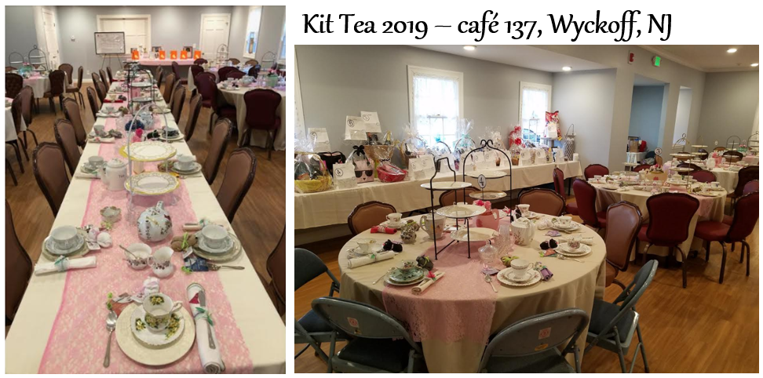
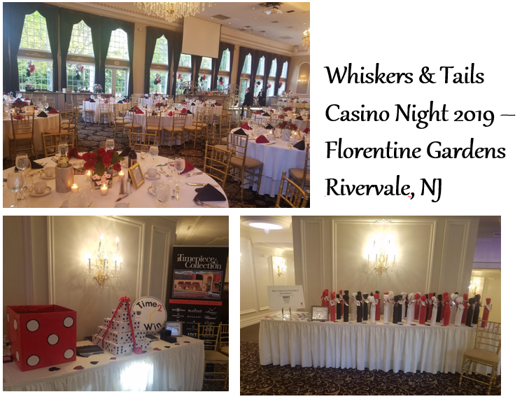

FUNDRAISING EVENTS – GO BIG OR GO HOME!
2019 promises to be bigger and better!
SOLD OUT!
Over 80 attendees, 60% MORE cat fanciers than 2017 launch!
200+ Guests
3,672 pieces of china, flatware, teapots & trays collected to serve our guests (or it seemed like it).
20 page program - our biggest ever!
$20,000+ in sponsorships, the highest sponsor revenue ever!
Over $5,000 in net profit generated, more than double 2017!
And immeasurable good will.

Slide 12
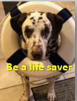
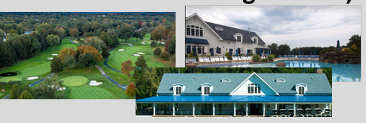
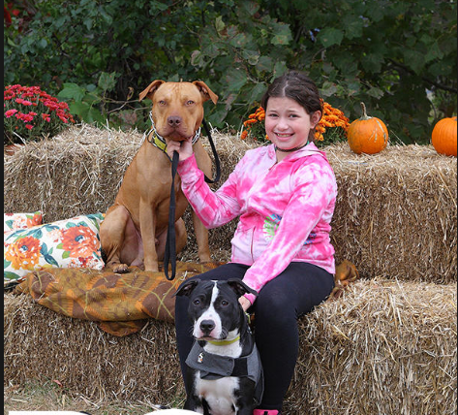
FUNDRAISING EVENTS – GO BIG OR GO HOME!
Coming up in 2019 - spread the word!
BC THE MAGAZINE CHARITY GOLF CLASSIC benefitting RBARI
TRICKY TRAY 2019
July 8th, White Beeches Country Club, Haworth
Partnership with respected NJ publication with extensive connections to local business leaders and individuals outside the RBARI audience.
A high-profile, less labor-intensive event that gives RBARI exposure to new prospective supporters without the demands of other events.
September 25th, The Venetian, Garfield
Our biggest prize demands, but our biggest money-maker
PITBULLS & PUMPKINS
October 20th, RBARI Campus
Total revamp to leverage the huge community opportunity at hand.
Turn a losing event into a profitable one through proactive, organized strategies
And let’s not forget the Oakland Carnival!

Slide 13
With aggressive goals to increase revenue towards the care of our animals, the support of volunteers is absolutely critical – inside the shelter and out.
To both new and longstanding supporters who have helped us in the past, and we hope will do so in the future, we say…
THANK YOU, SINCERELY!

Slide 14
Year to Date Comparison of Adoption Numbers
FOCUSING ON FOREVER HOMES
Adopted
Year End | January | February | March |  | April | May
2015 | 39 | 49 | 48 |  | 55 | 62
2016 | 54 | 54 | 48 |  | 50 | 60
2017 | 38 | 43 | 53 |  | 51 | 38
2018 | 65 | 34 | 60 |  | 37 | 32
2019 | 66 | 52 | 51 |  | 35 | 17
-April- we had ringworm in the cat kennel which slowed down adoptions
-Average length of stay of new intake from Jan 2019 is less than 2 weeks for dogs
-We are full of kittens, all of which will be adopted out quickly
-Tiny houses will help longer stay dogs become adopted faster by creating less stress in their lives

Slide 15
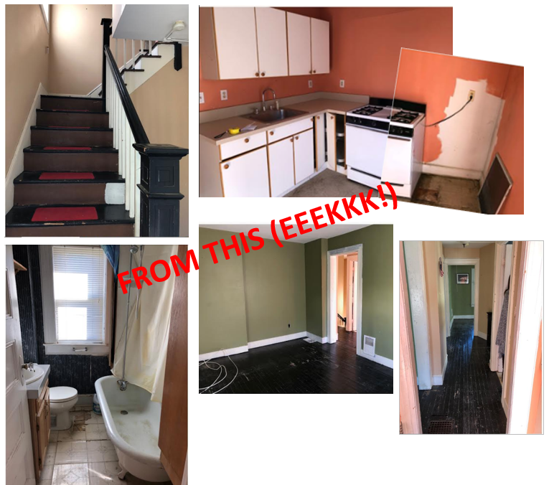
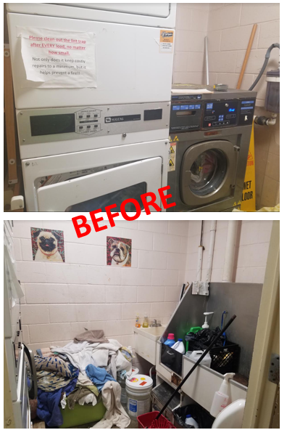
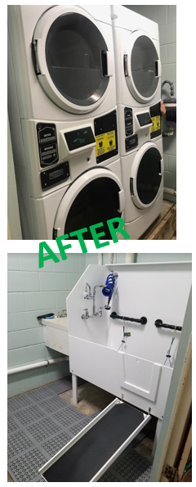
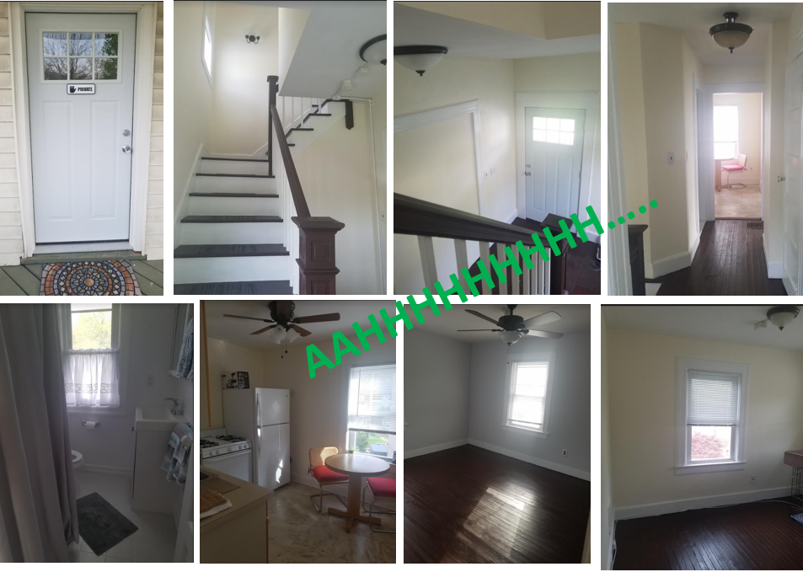
BUILDING A BETTER RBARI FOR THOSE IN OUR CARE
From renos, & repairs, to recent additions
TO THIS

Slide 16
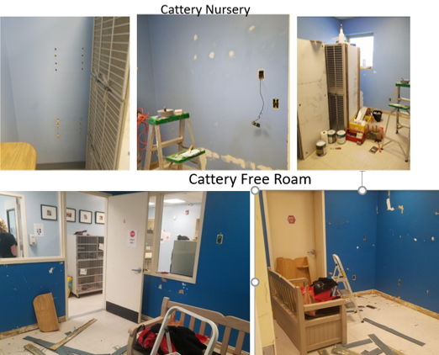
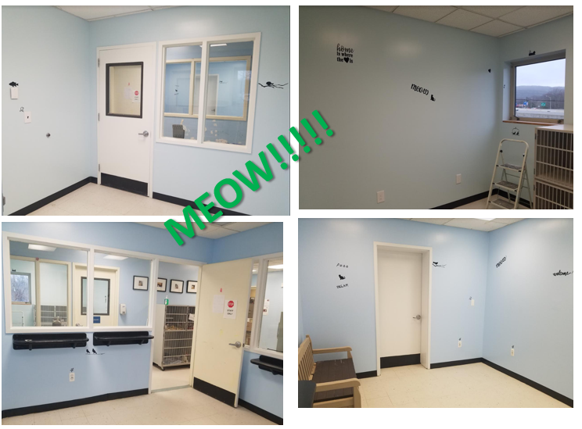

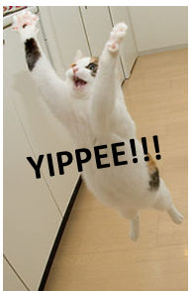
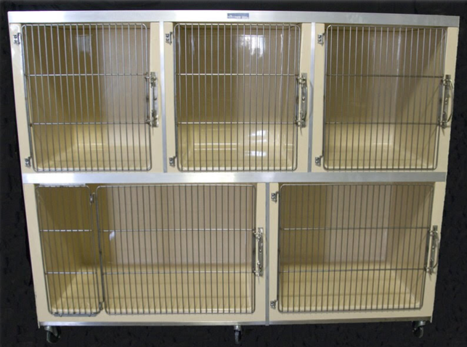
BUILDING A BETTER RBARI Cont’d

Slide 17
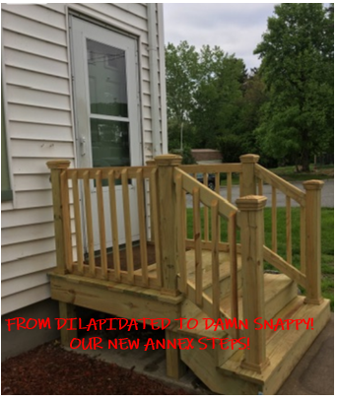
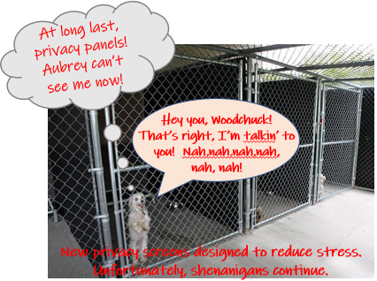
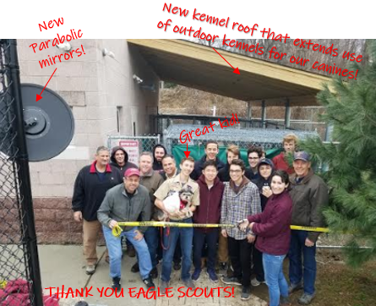
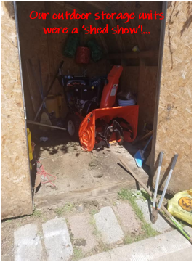
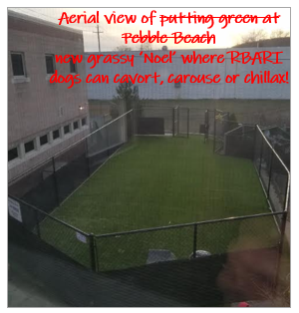
BUILDING A BETTER RBARI Cont’d

Slide 18
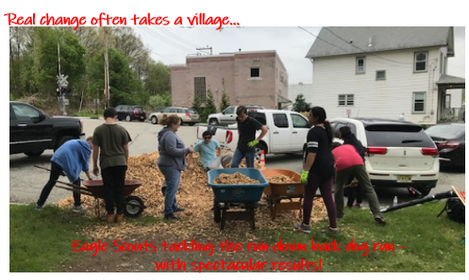
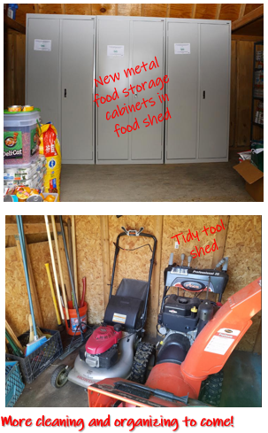
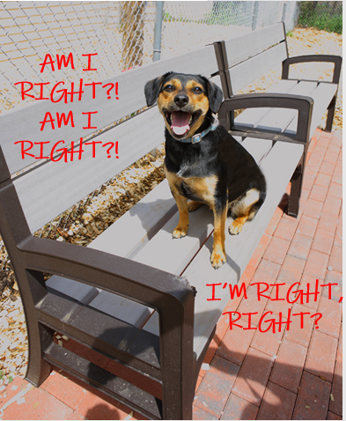
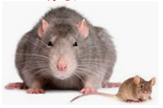
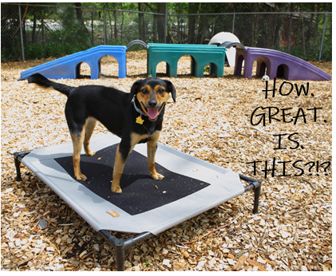
BUILDING A BETTER RBARI Cont’d

Slide 19
$115k+ worth of critical improvements to RBARI
Less than $50k actually spent
All since September 2018.
And there’s more to come.

Slide 20
2019 Goals
Tiny houses for dogs
Cattery revamp- optimizing space, adding a meet and greet room, and increasing area for intake quarantine and ISO
Main offices moving to annex
Revamp of our events
Launch of digital cheetah and upgraded volunteer software
More training and behavior work with dogs and cats
Adopting more dogs and cats
Increased sharing of our stories, appeals and messaging
Cross-training for dog kennel and front office staff for adoptions
Executing sustainability strategy laid out in earlier slides

Slide 21
RBARI in Action
A look at some of the lives saved

Slide 22
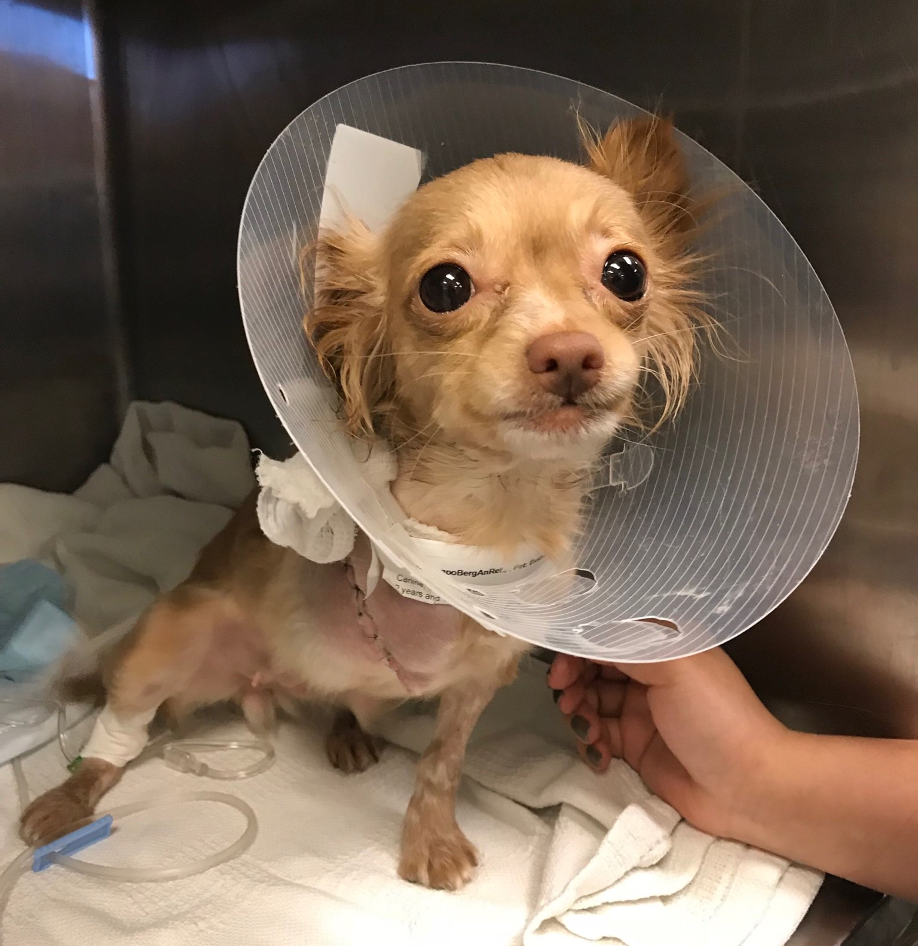
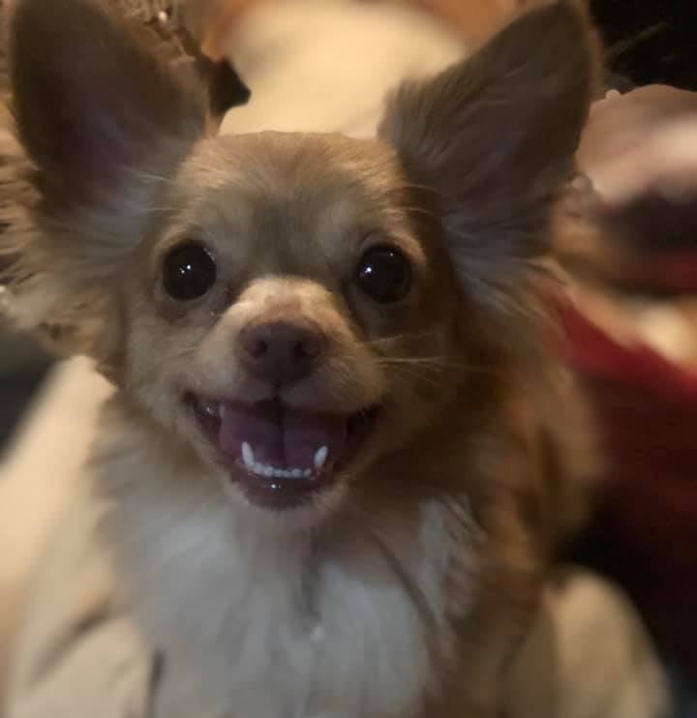
Buttons
RBARI rang in the New Year at Oradell Animal Hospital with this precious girl who had been hit by a car two days prior. Buttons’ owner couldn’t afford medical care for her, so Buttons had been waiting in pain with a broken leg and pelvis. Buttons couldn’t move, eat or go to the bathroom without excruciating pain. As soon as we heard, we couldn't let her wait a moment longer. Sadly, her leg was so badly broken that amputation was the only option. Buttons had a successful surgery and recovered beautifully. Buttons has adjusted to life on three legs and has a bright future now!

Slide 23
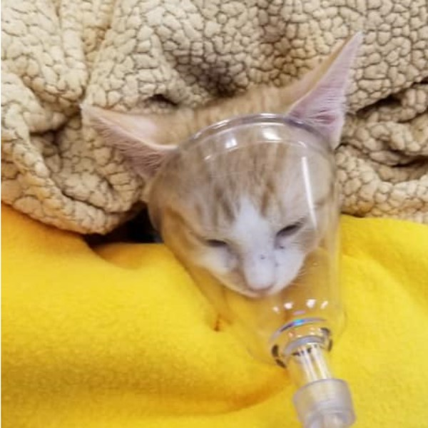
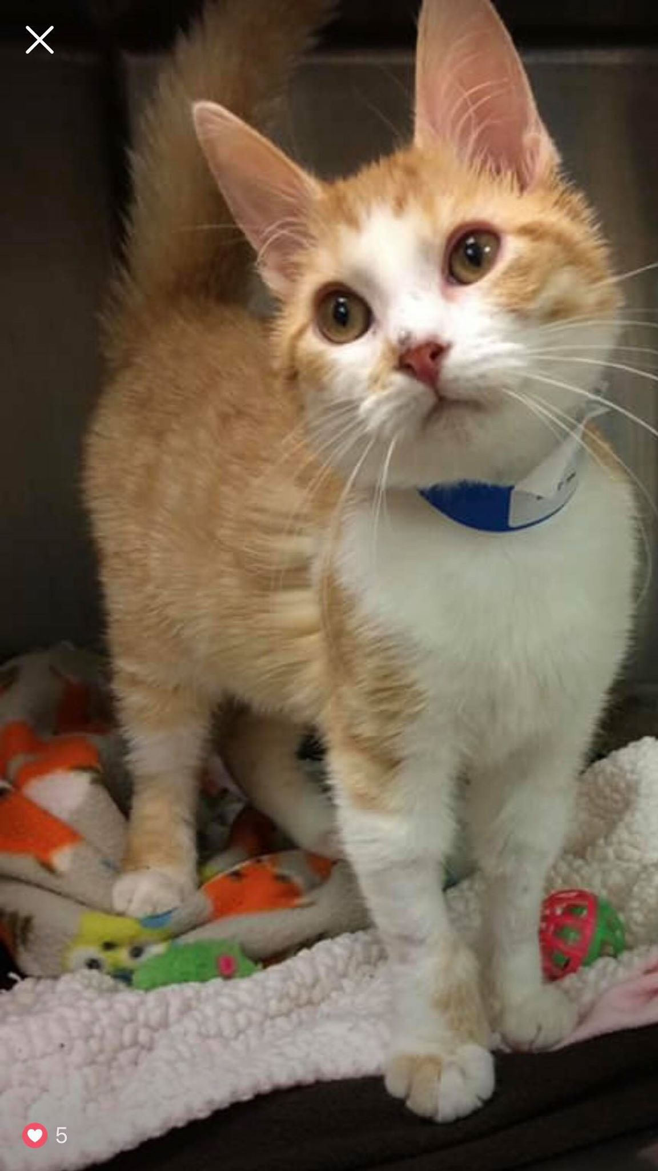
Jamie
Jamie hit the lottery when he was hospitalized at Oradell Animal Hospital after being attacked by a dog. Not only did he get the medical care he needed, but Jamie found his forever home. Jamie spent weeks at Oradell Animal Hospital as his lungs and broken ribs recovered. He unfortunately also had ringworm, but luckily, he found an amazing mom in one of his nurses who helped to nurture and care for him. She saw all the potential that Jamie had and loved him even with his scars. It was an incredible happy tails match!

Slide 24
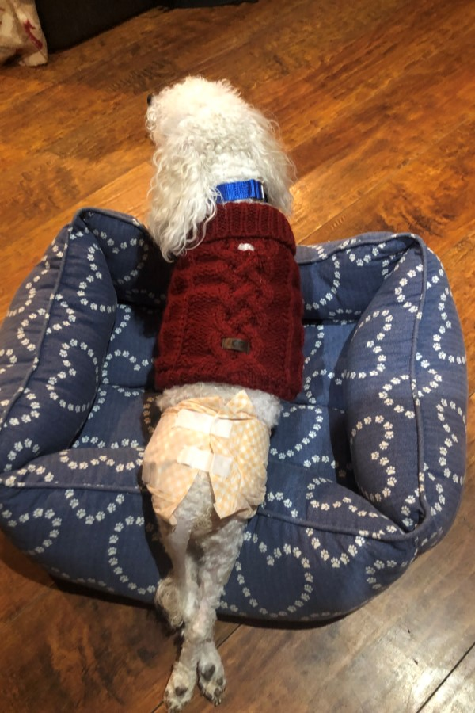
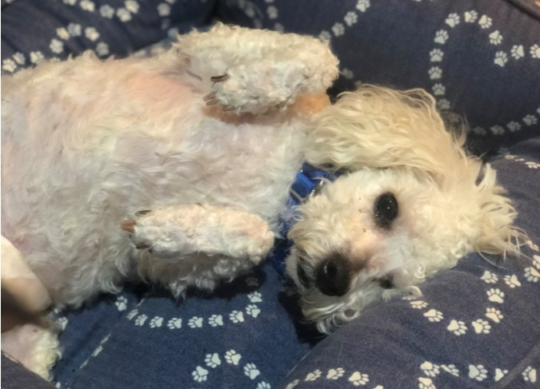
Munchkin
Munchkin, a tiny poodle, was paralyzed when he fell in his home. He received no medical treatment and dragged himself about for 4 months before being posted to Craigslist, then surrendered to RBARI. Munchkin is now improving every day as he works hard at his physical therapy. He has recently started walking on the underwater treadmill!

Slide 25
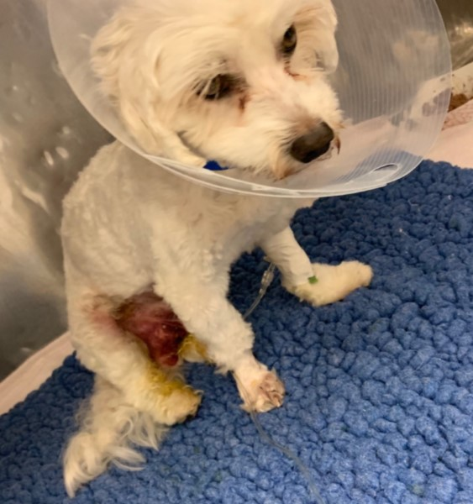
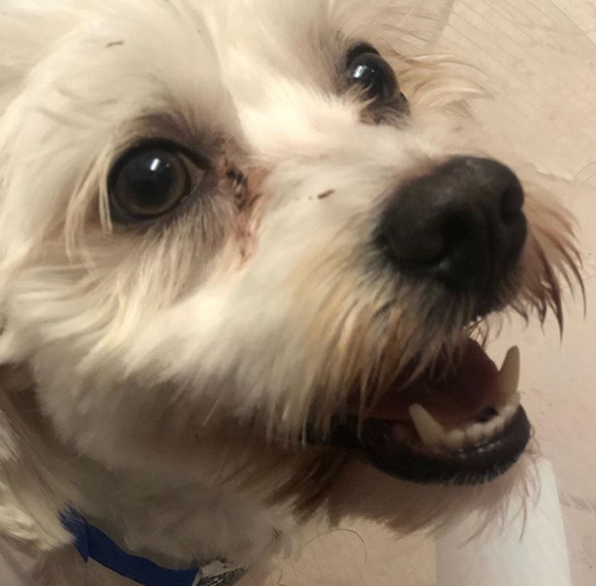
Finley
Finley was hit by a car and left for days without emergency care with broken bones and a herniated stomach. His owners brought him to the hospital to euthanize, but instead surrendered him to RBARI so he could have the life-saving surgery he so desperately needed. Finley had to be hospitalized for weeks due to the severity of his injuries and long recovery. He was then placed in a foster home and is doing well!

Slide 26
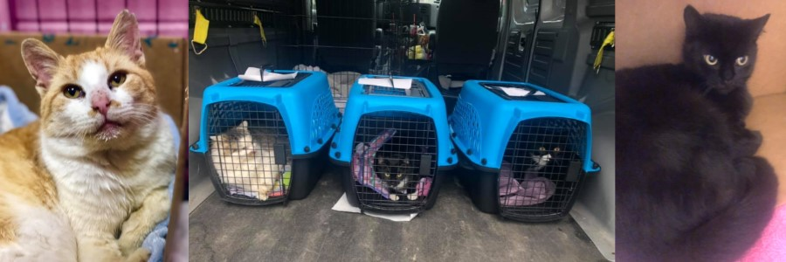
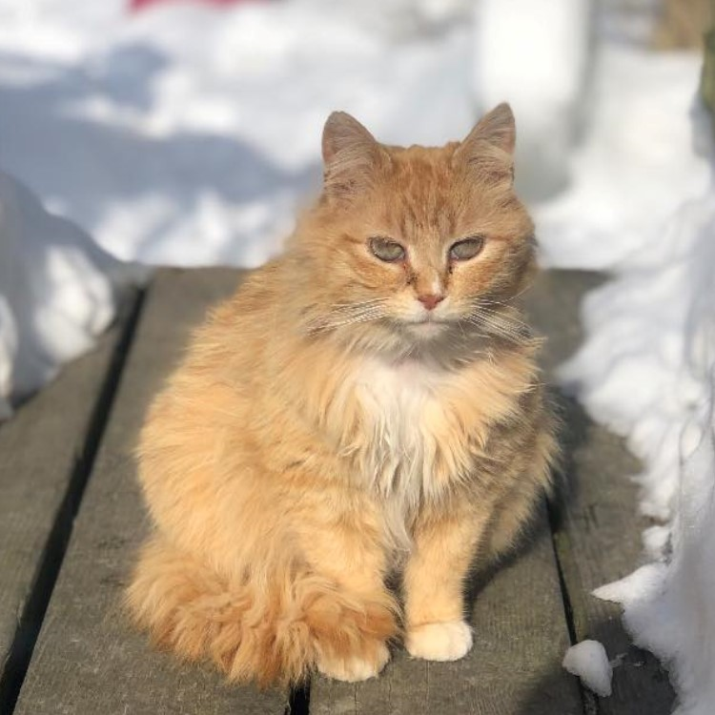
Trailer Cats
Twenty cats were living in a trailer facing eviction outdoors with threats of poisoning by neighbors. And, today, they have found hope thanks to an innovative partnership between rescuers, the Ramapo-Bergen Animal Refuge, Inc and two New England shelters with a demand for adoptable cats. The owner of these cats had fallen ill, lived without hot water, spent her last dollar to care for and feed the cats she had rescued from outside, and her trailer was days away from being condemned. We were able to empty the trailer just in time, and these cats are now all safe. Many had needed extensive veterinary care due to chronic illnesses and all needed some form or medical care. Several of these cats have been adopted and some remain on their journey to find their happily ever after.

Slide 27
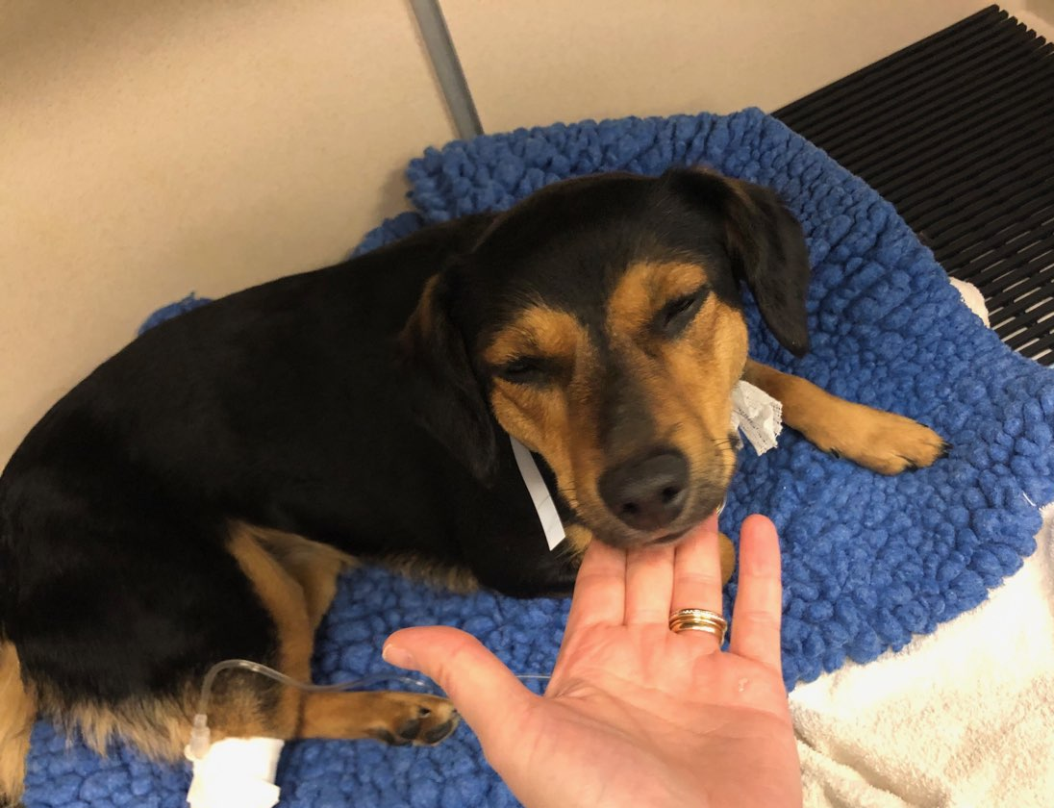
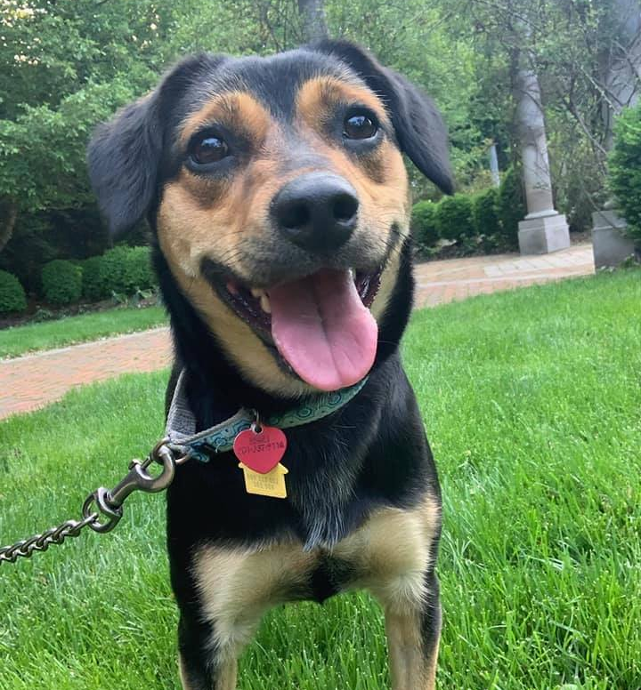
Chloe
Chloe, a beautiful beagle mix, was seizing uncontrollably when she was brought to the hospital. Her family opted for euthanasia over treatment. We were contacted just as Chloe was sedated to be euthanized, and we immediately took Chloe under our care. After testing, Chloe was diagnosed with epilepsy, and with medication, she has not had a seizure since!

Slide 28
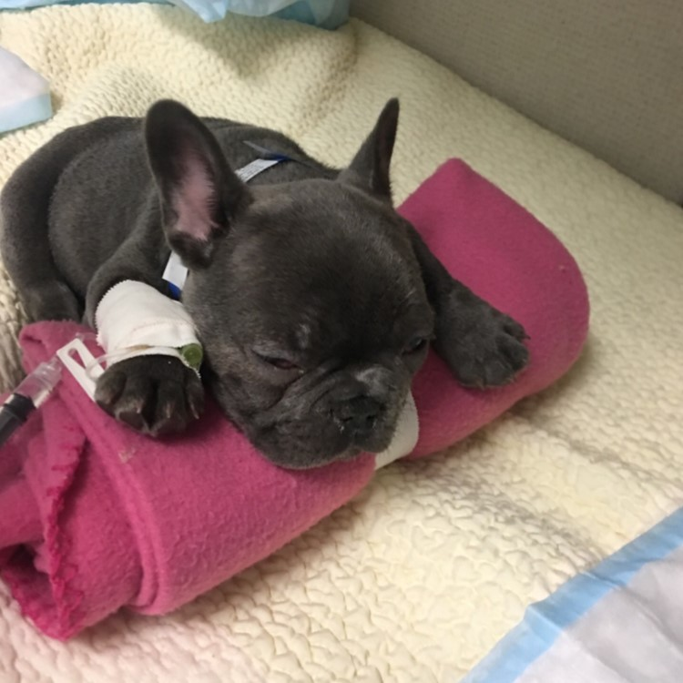
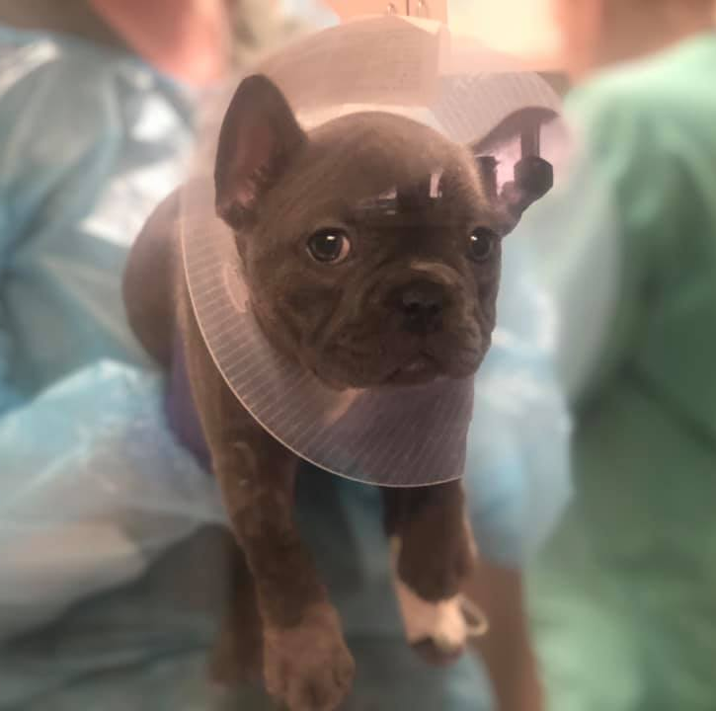
Louie
Louie, a tiny 8-week-old Frenchie with pneumonia, was helplessly lying in a cage, waiting to be euthanized by his owners because they declined to provide the medical care he needed to live. At only 5 pounds, Louie had a long, hard fight ahead. But, once we saw him playing after days of not able to move without great effort, we knew he was going to be okay! It took Louie extensive hospitalization to clear the infection due to his tiny size and a narrow trachea. Louie was able to recover from pneumonia and is now an active, sweet puppy. Louie was adopted by one of the doctors who cared for him.

Slide 29
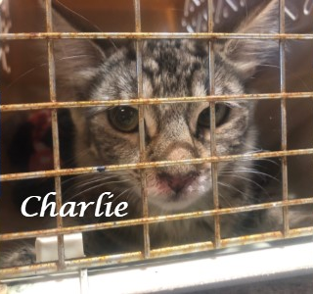
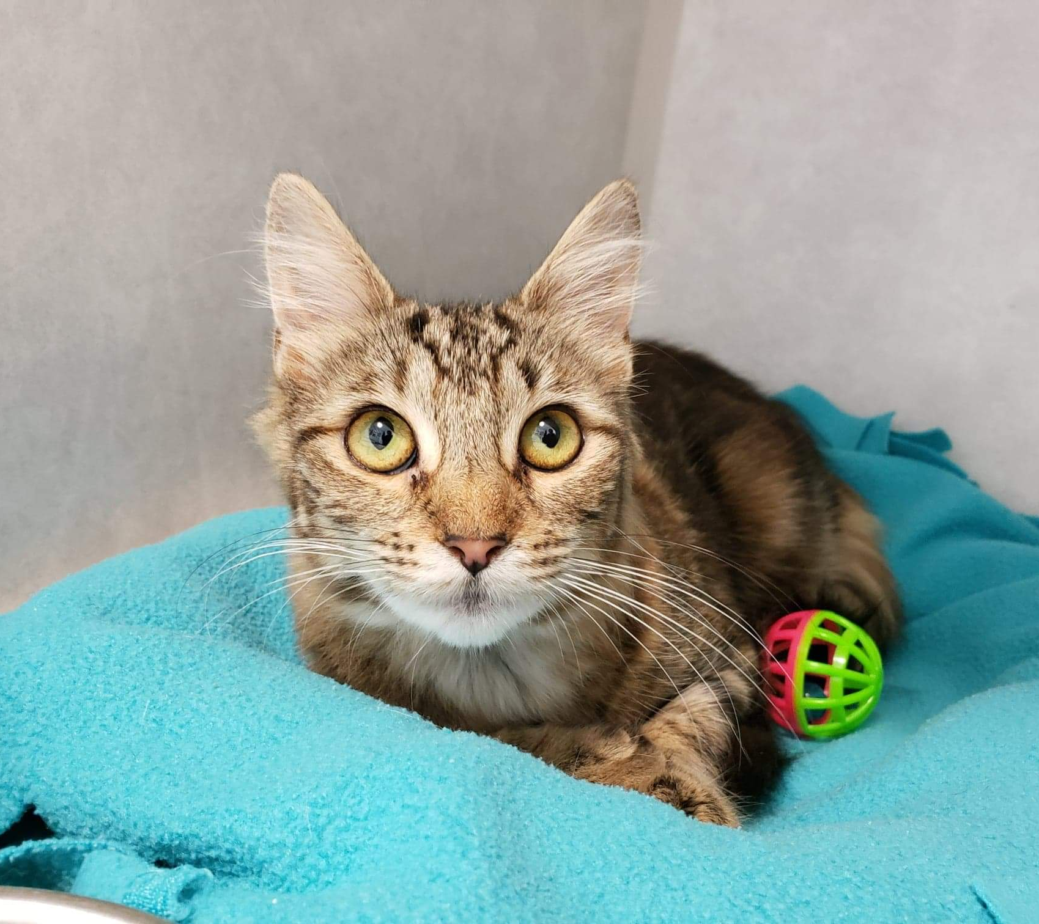
Charlie
Charlie was abandoned bleeding at the front doors of our shelter by a masked person who then sped off. Charlie was rushed to the hospital and treated for a respiratory infection and was soon adopted by a loving family!

Slide 30
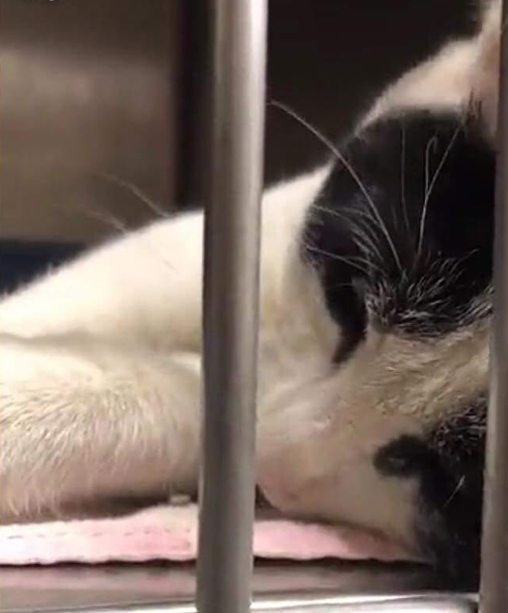
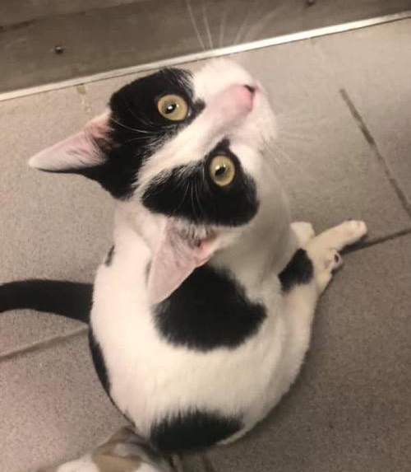
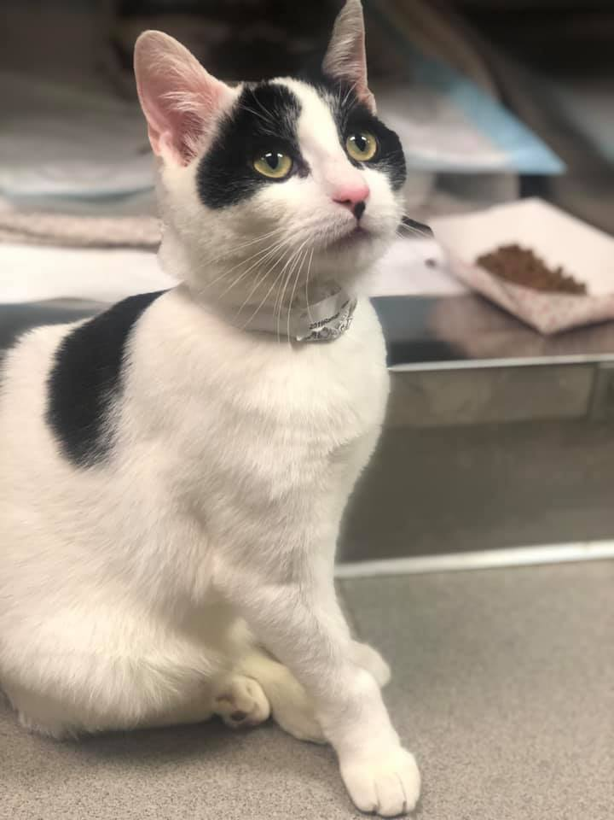
Oreo
Oreo was abandoned in a high kill shelter as a tiny kitten with hind-end paralysis. Oreo’s injuries have caused permanent damage, but with specialized care, he can live a playful and happy life.

Slide 31
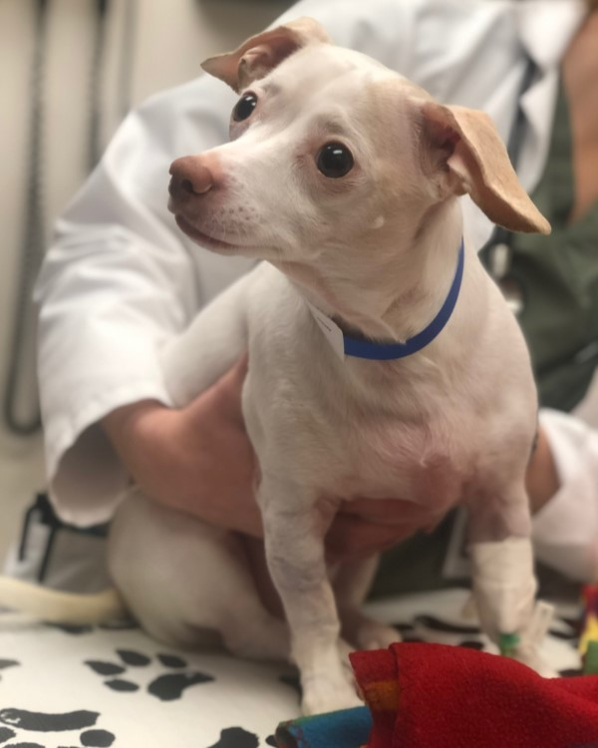
Woody
Woody was paralyzed upon rescue, but now can walk again because RBARI immediately intervened to provide the extensive surgery needed to give him a chance at a life of freedom and mobility. Woody had been passed from home to home after his owner passed away unexpectedly. He was in a temporary placement with family when tragedy struck. Woody jumped off the bed while playing and could not get up or walk. He was rendered paralyzed. Without immediate surgery, Woody would never walk again. Within a day, RBARI had taken Woody under our care and he had the surgery he needed to be able to walk again. Because of the availability of emergency medical funding, Woody now is walking, and even has a chance to run again. Woody is receiving physical therapy and rehabilitation and each day is making improvements. We look forward to the day when he is running around his forever home!

Slide 32
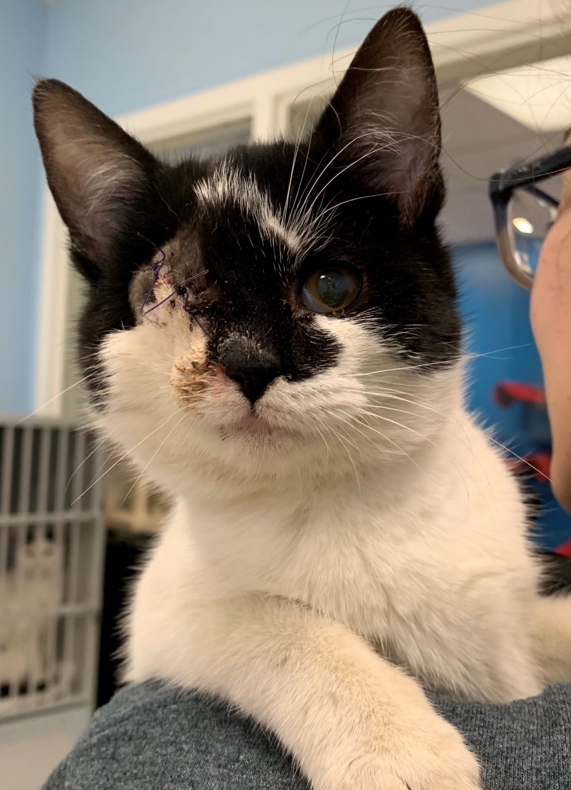

Annie
Annie was rescued from a high kill shelter as a tiny kitten. Her eye was badly infected and could not be saved. Annie was hospitalized and had surgery to remove the eye. She now is a happy, playful kitten who has no idea that she is different.

Slide 33


Bear
Tragically hit by a car and given up by his family in his moment of need, Bear's future looked bleak. But, just as quickly as he was abandoned, Bear was welcomed into the arms of RBARI and given a second chance at life. Bear had a break in his front left ulna and was scraped and bruised from head to toe. Bear enjoyed cuddling and stole the heart of everyone he met, so it was no wonder that this sweet boy found a forever home in now time!

Slide 34


Benji
Benji, a 4-month-old terrier / border collie mix puppy, was surrendered to RBARI by his owners after he began having seizures after receiving his initial vaccinations at a vet clinic. We immediately brought Benji to the emergency hospital to determine the cause of his seizures. He was diagnosed with GME, an autoimmune condition. He will be on immunosuppressive medication. Benji is currently at RBARI, seeking a foster or foster to adopt home. He is only 6 month old and an active puppy looking forward to finding his forever!

Slide 35


Chase
Chase is a beautiful, sweet cat who sadly faced euthanasia because of a curable urinary blockage that his owners declined to treat. With treatment, Chase has recovered, and he won the heart of a friend he met at the hospital who has now adopted him!

Slide 36



April
April was found, limping around an inner-city neighborhood on 3 legs struggling to take care of her two small kittens. She was docile and sweet, easily picked up and placed in a carrier, despite her pain. When she reached the hospital, April was relieved for help, but nervous. Sadly, April's leg could not be saved and required amputation. We soon realized that she had babies out there and went back for her two beautiful 7 week old kittens. At just 8 months old, April had suffered a tragic injury and birthed and cared for two beautiful babies. One of the doctors caring for April has fallen in love with her gentle, loving nature, and is fostering her with the intent to adopt. April is healing in the best hands possible and her kittens, Valentina and Vivienne, are warming up nicely to their new friends at the shelter and will soon be available for adoption!

Slide 37


Ripley
A feral young mom who had just given birth was found huddled against the side of a house with her 3 newborn kittens, trying to keep them warm on a rainy, unusually cold night. The babies had little chance of survival, and the mom appeared to be just a kitten herself. But, then, an amazing thing happened. They were spotted by a family who contacted RBARI, and within hours this tiny little family was safe and warm. We opened our doors at midnight to welcome this little family who may not have survived the night. Despite being a scared, feral cat in a busy shelter environment, this mama’s instincts have remained strong, as she nurses and cares for her babies. She was gifted the name Ripley, and is beginning to trust the staff members caring for her. The babies will be raised at RBARI then adopted out, and we will work with Ripley to see if she is adoptable or in need of a barn home.

Slide 38

Smiley
Smiley was rescued from a local inner city animal control and rushed immediately to the hospital. It was his second chance at life, but sadly Smiley was diagnosed with heart failure. Smiley is a 10 year old Pomeranian with very few teeth, but a great smile and a personality to match. His heart murmur is severe. Smiley doesn’t want you to know how sick he is – he puts on a good face, always so bright, friendly and happy! He even loves taking his medication, triple therapy heart medication which he will need for life, and dances around for attention. Smiley is desperately in need of a hospice home, where he can live out his days with a family of his own. He will need a quiet environment so he doesn’t get too excited – he doesn’t know how weak his little heart is. Lots of snuggles, lots of soft places to rest and lots of love is what this sweet boy is looking for!

Slide 39




Thank you for caring and making the work we do possible.
Bear
Chloe

